Slide 1
Introduction and guide to Genome-wide Association Studies (GWAS)
Session 04
Slides modified from AG2PI online workshop by Zihao Zheng (@zhzheng92)
Notes:
So how is everyone doing, my name is Andy and I am a fourth year PhD student in Cristobal Uauy’s lab.
Very honoured to have the opportunity to speak at this session today and be in Sfax. It is such a beautiful country and the seafood is amazing.
In this session, I will introduce and provide some general guidelines on genome-wide association studies and shared some of my experience when I was doing it.
Based on the survey, many of you already have experience with some GWAS, so please do add on anything if you think I have missed anything and I encourage you to ask question.

Slide 2
Objectives
Basic theory behind GWAS
How to conduct GWAS and useful software
Interpreting GWAS
What is next?
Notes:
So some of the objectives that we have today. We will go over some basic theory for GWAS.
How to conduct GWAS and some of the software that might be useful
How do you interpret GWAS, even if you personally do not do GWAS, it would nice to be able to interpret and understand the output from recent paper
And also briefly talk about what is next, what can we do after GWAS and more.

Slide 3
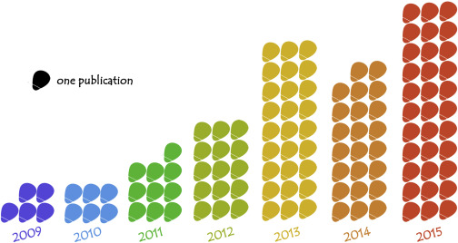
Genome-wide association study
Observational study to dissect genetic architecture of complex trait
Test an association of genome-wide genetic variants with variation in phenotype
Milestones:
  Developed in the context of human disease genetics in the mid 1990s
  First GWAS publication in 2002 (Ozaki et al. 2002)
  First GWAS publication in plants in 2005 (Aranzana et al. 2005)
Xiao et al. (2017)
Notes:
GWAS is an observational study to dissect genetic architecture of complex trait, these are usually continuous phenotypes such as height, flowering time and spike length.
Essentially we are trying to identify the genetic marker at which the variation in genotype is significantly associated with variation in phenotype. For example, if you have a A allele for this marker, you have earlier flowering time and for the G allele you flower later.
By identifying these marker-trait association, you are expected to get a better understanding of how your trait of interest is controlled. Which chromosome regions are controlling our trait of interest, and do these regions have a big effect or smaller effect in our trait of interest. Later on these information can help you develop genetic marker that can help improve your trait of interest in breeding via marker-assisted selection. And with more genomic and validation tools becoming available in wheat these days, these information can also help support the identification of the underlying gene for your trait of interest.
Some milestones in GWAS: GWAS first developed in the context of human disease genetics in the mid 1990s. In fact if you have done 23 and me similar to what Cristobal was showing yesterday, sometimes they give you how likely are you to have dark. Some of these readout they are giving you are in fact based on GWAS.
First GWAS was publication in 2002 and then in plants in 2005. But since the establishment of method, it has been widly adopted in the plant community. This graph looks at the number of maize GWAS study that has been published since 2009 which I think was the released time of their reference genome. And as of 2020, there has been over 200 publication of GWAS for various traits in wheat

Slide 4
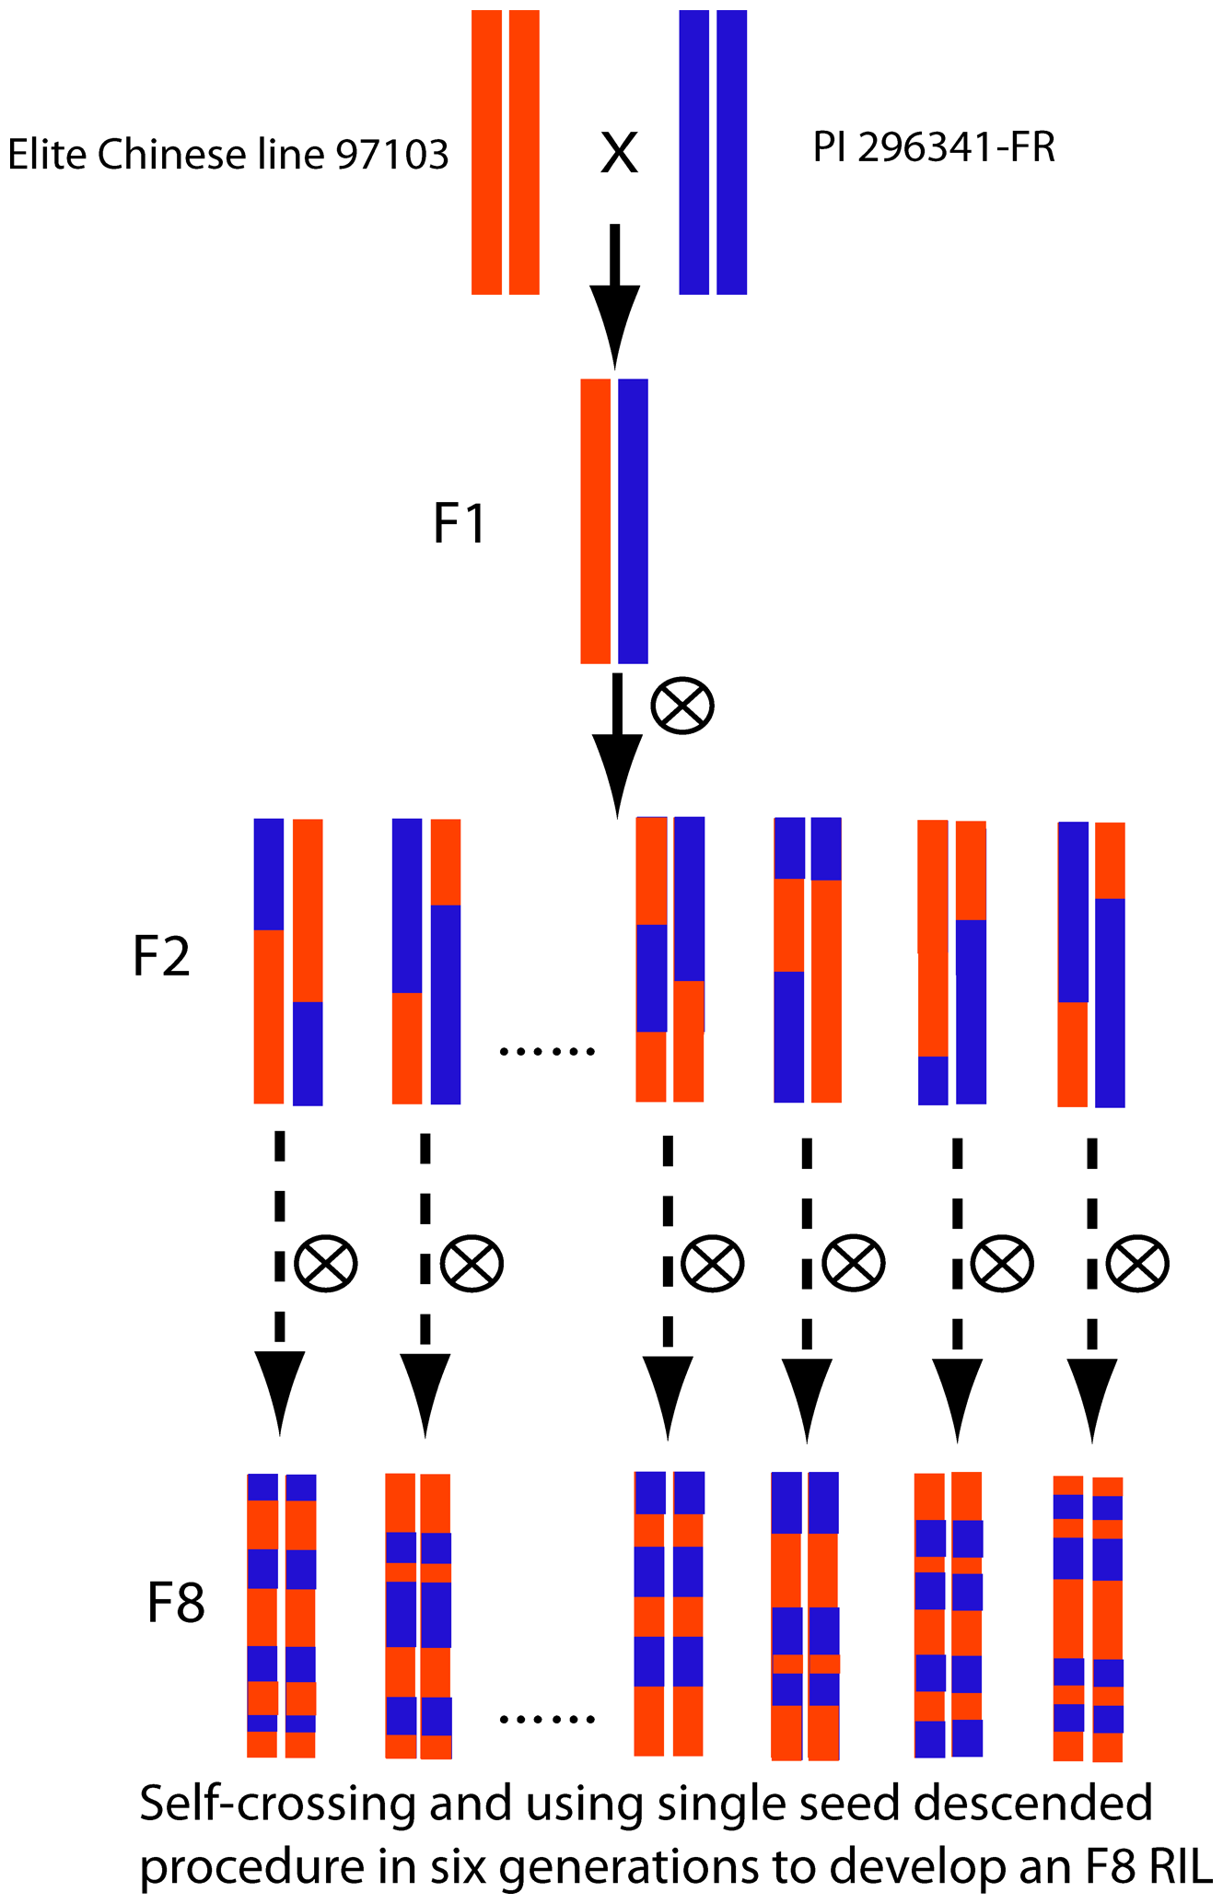
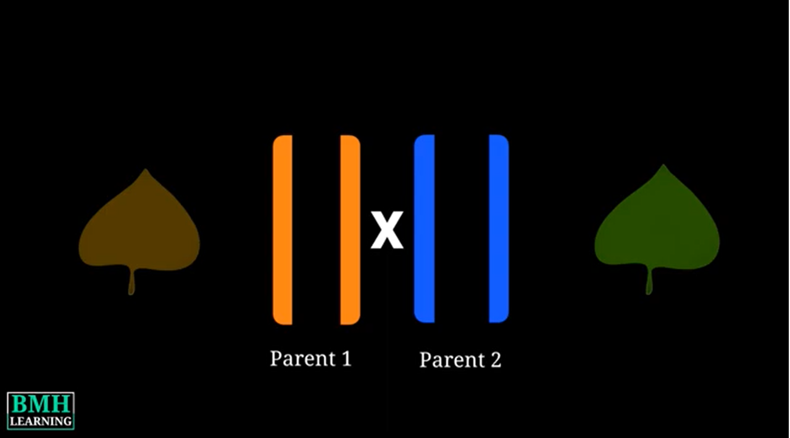
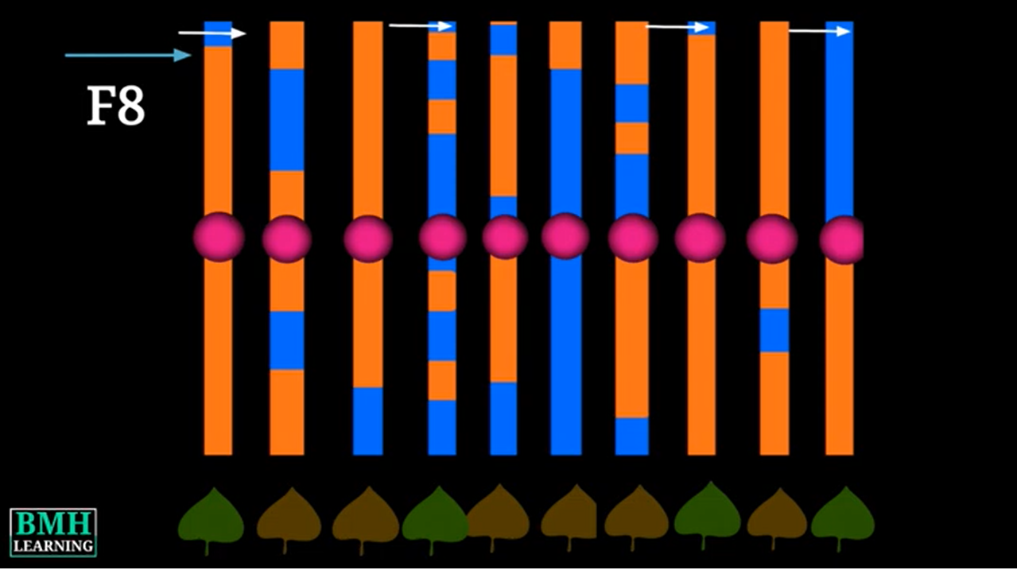
Linkage analysis
Test for the co-segregation of genetic polymorphism with the trait to identify the location of the genetic locus
Usually use bi-parental population
Resolution is dependent on recombination
Ren et al. (2012)
Notes:
So before we get into GWAS, I will get into some other method that as used in the past to identify genetic region affecting the trait of interest
The first method that people often use to identify genes that can affect a certain trait is via. QTL mapping or linkage analysis.
Essentially, QTL or quantitative trait locus are genetic region/chromosome segment in which the allele can affect the variation of a quantitative trait or as Cristobal has shown in his presentation, these complex traits that.
In the QTL mapping, we test for a co-segregation of genetic polymorphism with our trait of interest
In this example, we want to identify the QTL that can affect leaf colour.
We made a cross parent 1 that has brown leaf and parent 2 that has green leaf. The DNA fragment from parent 1 is denote in orange while chromosome region from parent two is represented by blue.
At the eighth generation, we can use both the genotypic information and the phenotype to locate the region of the chromosome that controls our trait of interest.
In this scenario, any plant that has the parent two DNA fragment at the top of the chromosome has green leaf while any line with the orange (DNA from parent 1) has brown leaf. We observed this close association between this chromosome region to our trait of interest, therefore we can conclude, the genes that control leaf color must be in this genetic region.
The resolution is dependent on the amount of recombination, in this case, the F2 there is not as much recombination, whereas in F8 you got more recombination so it can give you a better idea of where that genetic region of interest is.

Slide 5
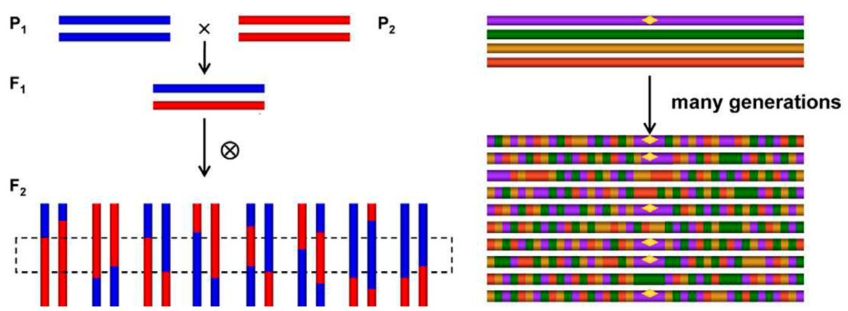
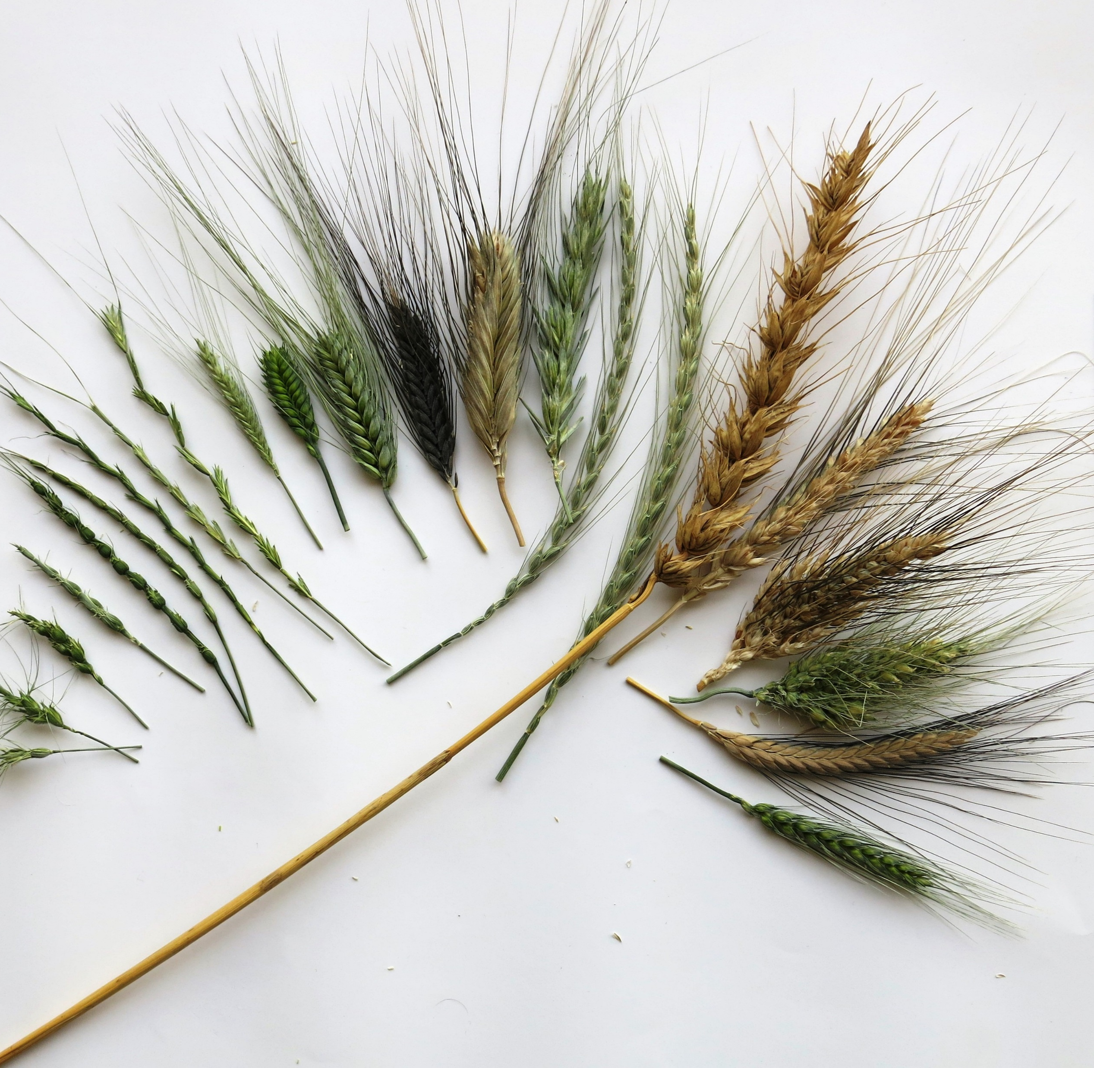
Genome-wide Association studies
Use diverse collection of material to find association between your trait of interest and genetic marker
Higher resolution; Reduce time for material generation
Notes:
The goal of GWAS is same to that of QTL mapping: we want to identify the genetic region that is associated with our trait of interest. And this can be to disease resistance, Septoria like what Sonia is doing or to resistance to abiotic stress like tolerance to drought or tolerance to salinity in the soil.
GWAS usually uses a diverse collection of material (bigger than 200), these can be diverse Tunisian landrace or can be a collection of Ae. tauschii like what Brande has mentioned in his presentation
But GWAS has several advantages, first of all, it has higher resolution.
Here again we have an example of the F2 of the bi-parental population, where it only has one generation for recombination, so for your result, you will usually find that a large section of the chromosome co-segregate with your trait of interest. But in GWAS, you can make use of diverse collection of germplasm which over time has accumulate lots of recombination which gives you higher resolution (smaller genetic region) as to where the underlying gene that control your phenotype might be

Slide 6
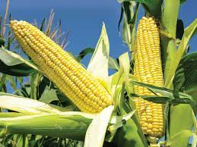
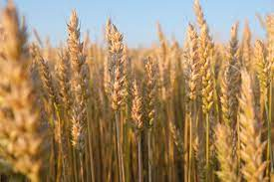
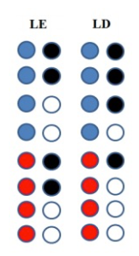
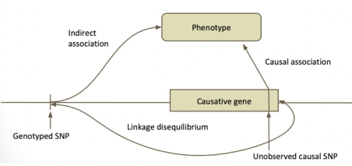
Association mapping
The statistical method identifies marker-trait associations (MTA)
This is dependent on the strength of linkage disequilibrium (LD) between the markers and the functional polymorphism across the set of diverse germplasm
M1
M2
Notes:
Association mapping is dependent on the strength of linkage disequbilirum between the markers and the functional polymorphisms across the set of diverse germplasm. Linkage disequilibrium described The non-random association between two or more loci in a population, in general but not always it is dependent on the function of distance. Physically in the chromosome
So here we have a brief example of two marker, M1 and M2. because they are in linkage equailibirum. They are not associated with one another. So if you have blue in the first one, you can get either black or white. Whereas the two markers that are in LD, we see this non-random association where if you have blue at marker 1, you are more likely to get black in marker two .
This is very important concept which is the core idea behind association study.
Because, more often than not, similar to what Cristobal is describing yesterday, usually it is too expensive to sequence the entire genome and get all the SNP data, but as long as you have a good spread of your markers, you are expecting that this genotyped SNP is linkage disqubilibrium with the actual causal SNP.
This would still allow you to detect your genetic region of interest.
Therefore, one of the consideration is your marker coverage. And this can differ between different plants.
For example, maize is an outcrosser, you are expecting more recombination, and therefore you are expecting the LD block to be smaller (100 kb). LD block is kinda of a general description of region of genome genetic variants that are inherited together.
In wheat or barley, because of self pollination, our LD block is typically bigger dpepending where it is can be from 1 to 5 Mbp. So I was quite shocked yesterday when Sonia was talking about her study in Septoria, where she saw the LD block to be around 80 bp

Slide 7
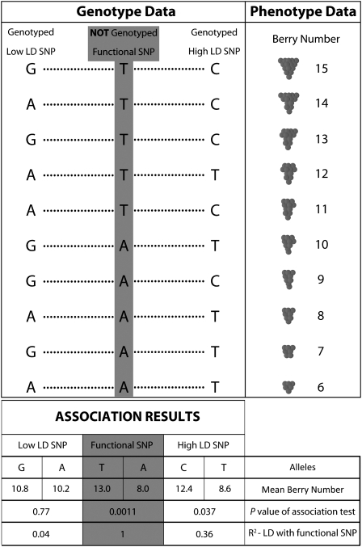
Good marker coverage is key
Myles et al. 2009
Notes:
Just to really get the concept of linkage disequilibrium across: we are going to look at an example of GWAS looking to identify gene that controls berry number.
Each row represents individual plant that is part of the GWAS study.
There is a functional or causal SNP here that controls the number of Berries. So if you have T here, you have number of berries where as if you have A here, you have lower number of berries
On the right hand side, you have a genotyped SNP that is in high LD with the causal SNP, this can be because they are physically very close to one another. Here you can see, similar to the example we were talking about earlier where if you have T here, you are more likely to have C. So they are linked
On the left hand side, you have genotyped SNP, that is in low LD with the causal SNP, this can be because they are very far apart. So here you don’t really see a pattern. When you get T here, you can get G or C. It is almost random, so they are in low LD.
If we perform association analysis in this case, even if we do not genotype the causal SNP, the high LD SNP still show a significant association with mean berry number where as the low LD SNP marker do have a significant association with the trait.

Slide 8
Linkage mapping and association mapping
 | Linkage mapping | Association mapping
Pro | Relatively smaller population size Genetic marker with lower density Detected QTL can go through fine-mapping | High allelic diversity No crosses needed Take advantage of historical recombination, higher resolution
Con | Low allelic diversity Material generation takes time Limited recombination, lower mapping resolution | Require large population size to detect QTL Challenges with low frequency alleles Optimize with high density genetic marker Will always need future validation
Notes:
Just a brief comparison between linkage mapping and association mapping:
In linkage mapping: you have relatively smaller population size. And for in terms of genetic marker, it usually can be at lower density, because you want to observe the co-segregation.
Once you have detected the QTL you will then need to do fine mapping

Slide 9
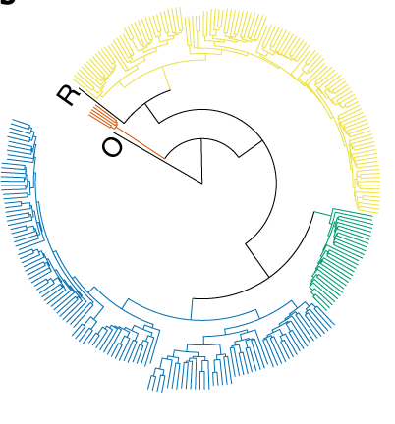
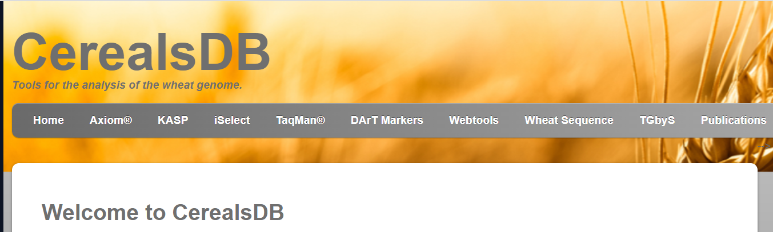
Consideration for Germplasm Selection
Carefully consider all genetic aspects and available community resources
  How was the diversity panel assembled?
  Phenotypic diversity
  Genetic diversity, genome-wide LD
  Genetic marker availability
  Determine the appropriate size and number of markers
Ren et al. (2012)
Notes:
Population that have already been genotyped…. We will go into more detail regarding these population, later on or what Brande has mentioned yesterday, these tauschii accessions

Slide 10
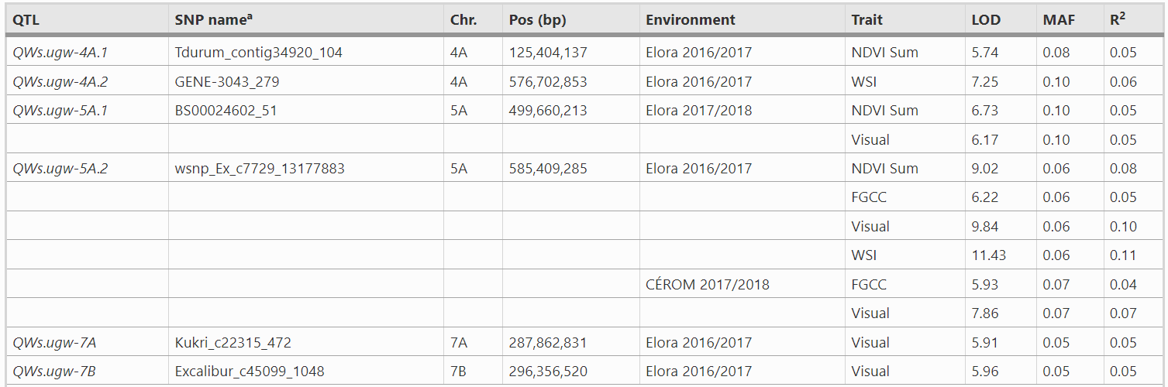
Considerations for your phenotype
What is the heritability of your trait?
Replication?
Notes:
Abiotic stress tolerance, drought stress.. Lack of rain at the beginning of the season, lack of rain later on.
Similarly, I also used to work on abiotic stress tolerance specifically winter surivial.

Slide 11
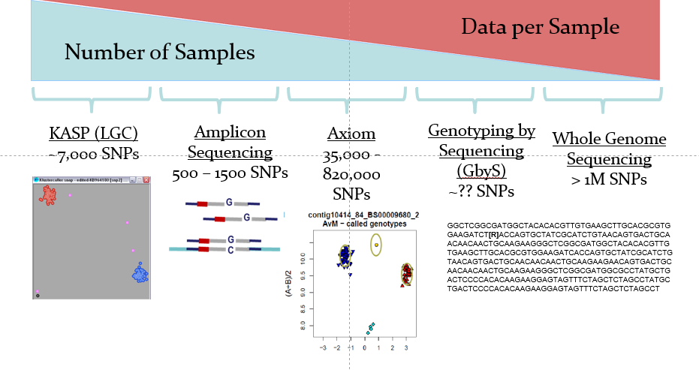
Consideration for genotyping

Slide 12
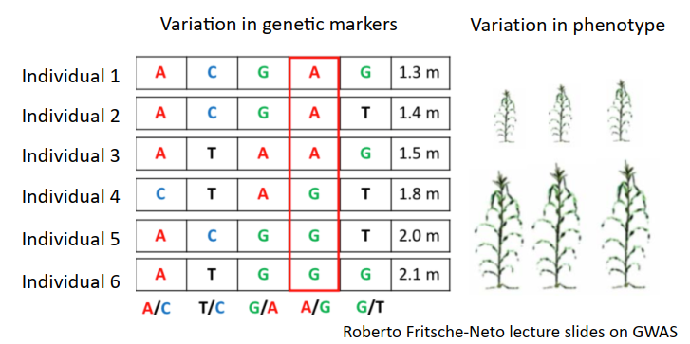
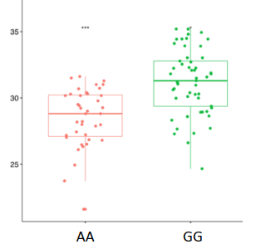
The start of GWAS
Naïve model: t-test
False positive accumulates across large number of markers
Does not address the genetic background of the population
Notes:
So I will briefly go over some of the underlying statistical idea behind GWAS. It is not my specialty but a general understanding of the statistical model will help you understand the strength and perhaps also the weakness and limitation of the method
At the very beginning of GWAS, you can think of it as a T-test, so you will testing whether the accesstions that have A in this phenotype are taller than the accession that have G. and in this case AA is shorter than GG. Then this would be a significant marker-trait assosciation.
Now when we perform a t-test, we usually have what we called a statsticaly significant value P value more or less the likelihood of getting a result that is as extreme as the one you observed, given that there is no true difference or relationship between the variables being compared.
So lets assume your p-value is set at 0.05, but if you have 90 K snp marker, just by chance alone, 4500 of these marker will be associated with your trait of interest.
Also this naïve model of t test does not adrdress the genetic background of the population which more often than not will also give you false positive.

Slide 13
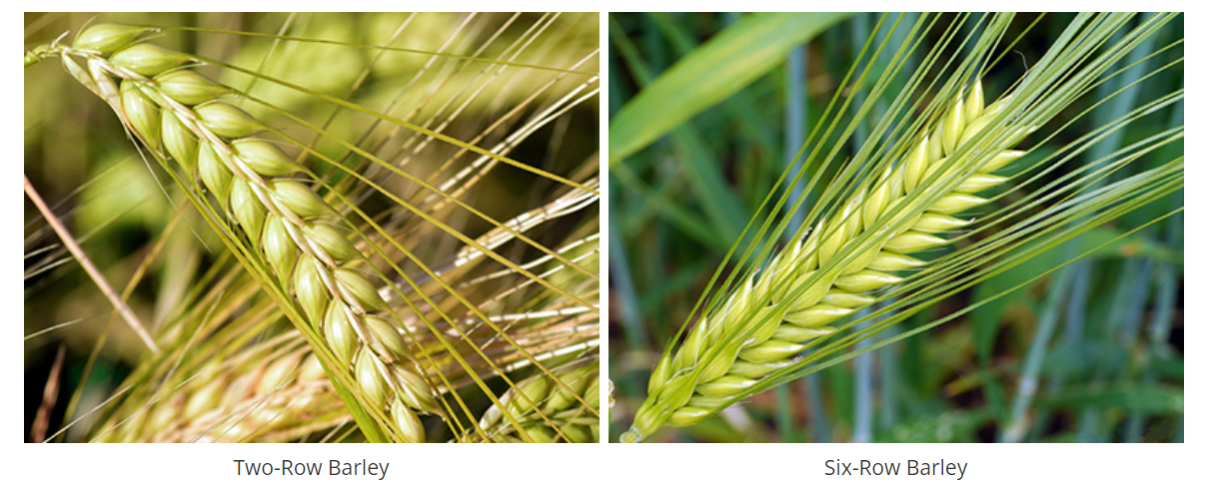
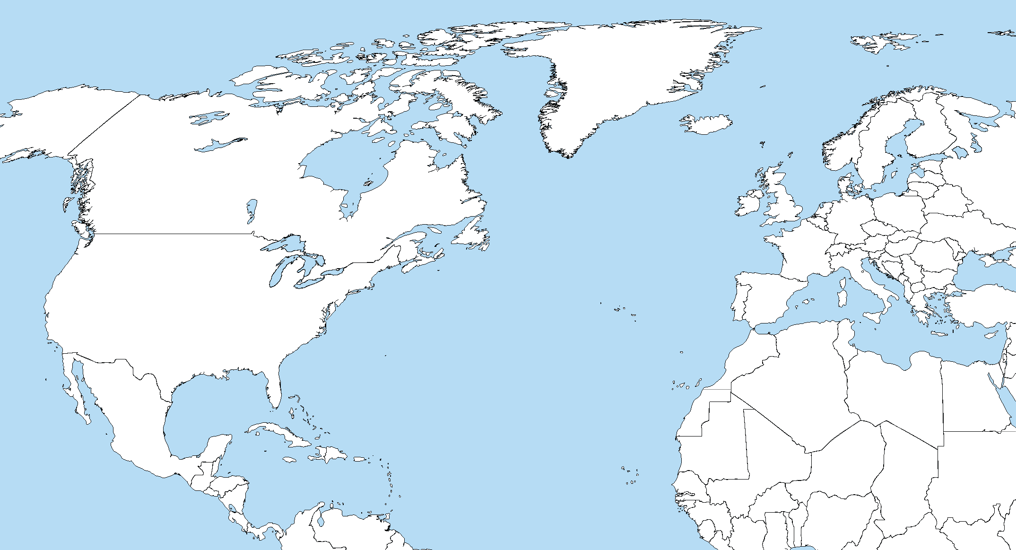
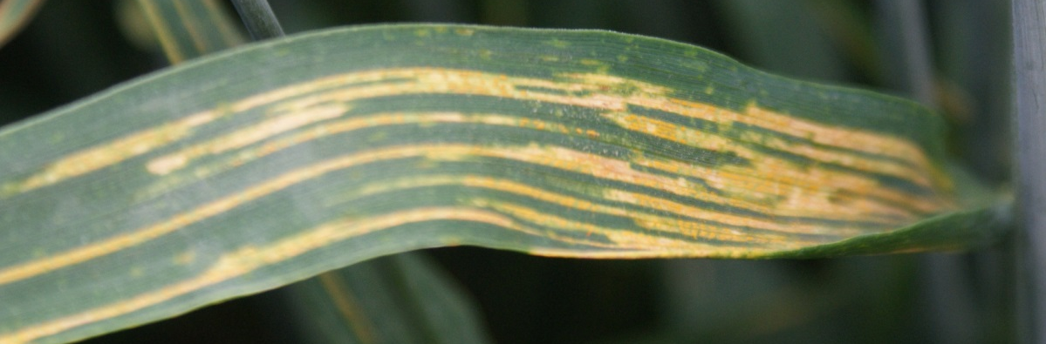
Population structure and false positive
Systematic difference in allele frequencies between subpopulation
Two-row
Six-row
 | North America |  |  |  | North Africa
Row Type | 6 | 6 | 6 | 6 | 2 | 2 | 2 | 2
Row type Causal SNP (A/G) | A | A | A | A | G | G | G | G
Disease resistance (DR) | R | R | R | R | S | S | S | R
DR causal SNP (C/T) | C | C | C | C | T | T | T | C
Notes:
Population structure and false positive:
Population structure refer to the presence of subpopulation within a larger population that are genetically distinct from each other. This can be caused by factors such as geographic isolation, migration and more. Population structure is important because it affect the distribution of genetic variation that can lead to spurious association with traits.
Human for example, European in general can tolerate lactose, they can drink milk, but they also have higher percentage of people with blue eyes.
So lets say for example I am performing GWAS for tolerance towards lactose, I will likely identify an association at genetic region that control eye color. And that is just because in this subpopulation, there is higher frequency for eye color and tolerance towards milk
Genetic variants do not necessarily cause change in the phenotype we are interested in.
The terminology two-row vs. six-row is derived from the physical morphology of two different types of barley. A single gene out of roughly 30,000 in barley causes the development of either two or six kernels consecutively along the barleys head. Both types have alternating sets of three spikelets,, however in two-row barleys only the central spikelets are fertile and develop seed creating a flat shaped head. Six-row types have a rounded head appearance with all six kernels developing.

Slide 14
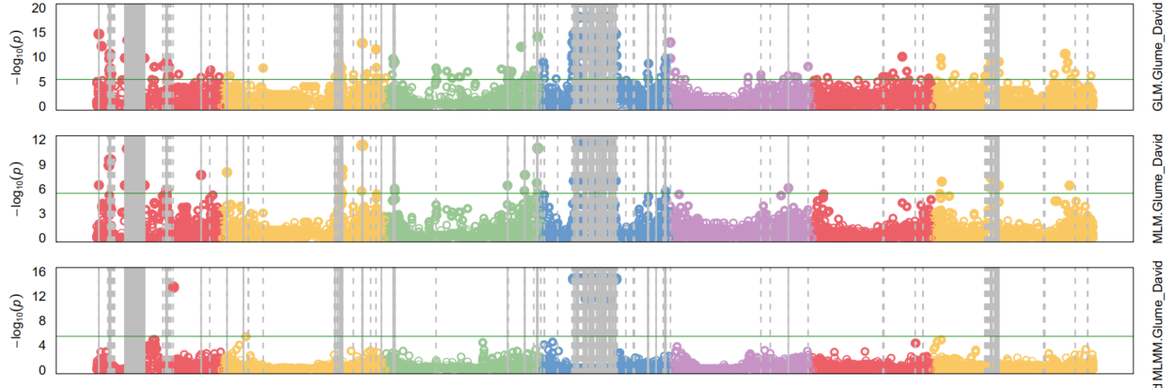

Notes:
Pause here

Slide 15
Relatedness among individuals: kinship
Unequal familial relationship
Familial relatedness from recent co-ancestry among individuals usually exists in a collection of diversity panel which can lead to spurious association
  Can be estimated by SNP markers
Notes:
Kinship refers to the degree of relatedness between individuals within a population, typically based on their genetic similarity. This can be measured using genetic markers such as single nucleotide polymorphisms (SNPs). Kinship is important in genetic analysis because it can affect the statistical power of genetic association studies and influence the interpretation of results. For example, kinship can lead to false positive results in association studies if individuals are more likely to share both genetic variants and traits due to their relatedness.

Slide 16
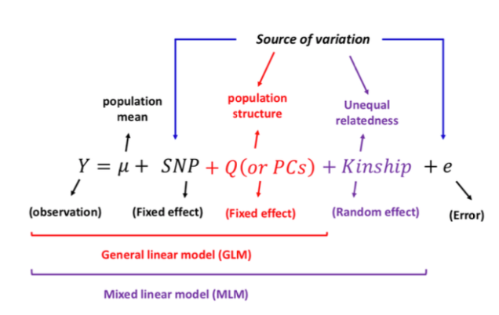
Mixed linear model
A unified mixed-model framework for association mapping that accounts for multiple levels of relatedness
  Controls for population structure estimated by the SNP data (STRUCTURE or principle component analysis, PCA)
  Control for unequal familial relationship using kinship matrix
Notes:
So the statistical model then want to account for this
Essentially, the model is asking, if we account for population structure: which in literature is referred to as Q and if we account for kinship. Does the SNP marker have a significant effect on what you obeserved

Slide 17
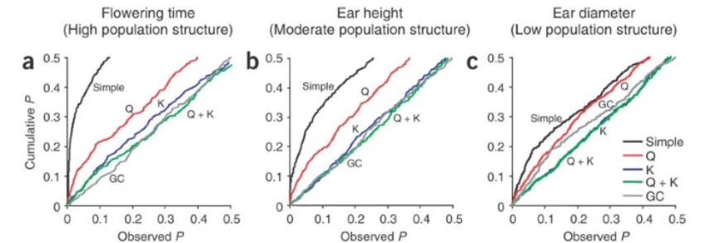
Mixed linear model framework
By controlling for population structure and kinship at the same time, mixed linear model reduce false positive in GWAS
Yu et al. 2006
Notes:
Under the expectation that random SNPs are unlinked to the polymorphisms controlling these traits (H₀: no SNP effect), approaches that appropriately control for type I errors should show a uniform distribution of P values (a diagonal line in these cumulative plots). T

Slide 18
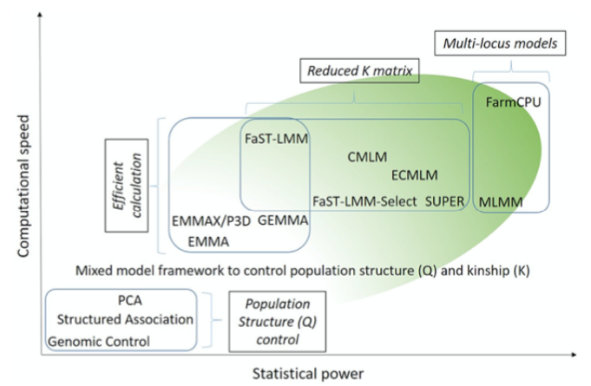
Improvement of GWAS models
Improvement have been made based on mixed linear model
  Increase computational efficiency
  Increase statistical power
Alternative framework for
GWAS
  Bayesian methods: Bayesian RR-BLUP, BayesA, BayesB…etc
Cortes et al. 2020
Notes:
Pause here

Slide 19
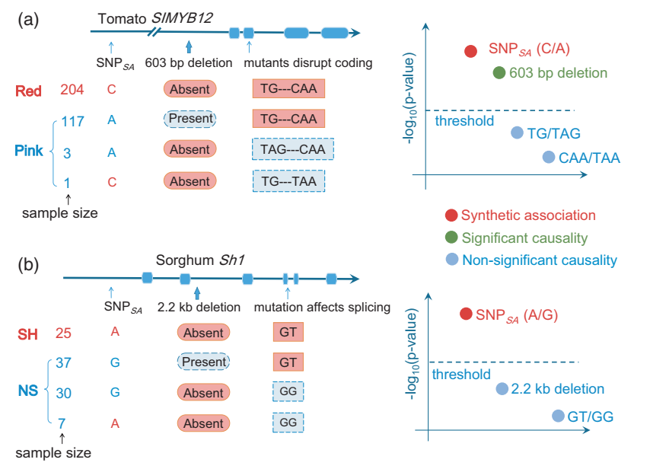
GWAS Challenges
Loci with minor allele frequency
Need validation
How to establish appropriate significance threshold
Synthetic association: causal gene located away from the GWAS peaks
Liu et al. 2019
Notes:
How to deal with loci with minor allele frequency (low sample size, more false positive). They have would have smaller p value, but lower confidence.
Synthetic association: the causal gene is sometimes located away from the GWAS peaks, Sorghum shuttle one 1. This can be because of many reasons, one of them is because that there are multiple allele leading to the phenotype.
But cause non shattering, just by chance alone the G at the SNP marker is more closely linked to the trait even though it is non causal. So
The 2,2 kb association, mutation effect splicing.
You can only genotype the SNP.
The GWAS snp is not guranteeded to be causal
Rare allele hypothesis: The rare and large effect causative variant is linked to a common marker.
This explains the missing heritability, because the tagged marker can only explain a fraction of the trait variance
Trait variation can be caused by multiple allele within one gene! Since mutation constantly generate new variant, multiple independent allele within one gene lead to the same phenotype should be possible. Haplotype and gene-based methodology can potentially bypass that
Example: there are three causal snp (deletion and the missense mutation) that can lead to change to red to pink. The SNP is not causal but just by chance, it is linked to the phenotype. While the other causal ones are not as significantly associated because the allele is different.

Slide 20
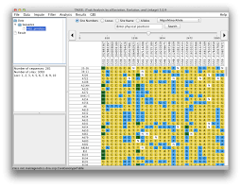
Some tips on getting the marker data right
Filter SNP markers before GWAS
Minor allele frequency (MAF). Eg: MAF < 0.05
Markers in complete linkage (r² = 1)
Markers with high missing rate (> 25%)
Heterozygosity rate
Notes:
There are no gold standard.
In wheat sometimes we filtered out heterogzygosity rate

Slide 21
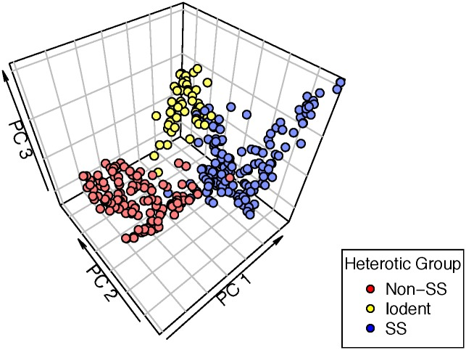
Address relatedness among individual
Methods to control for population structure
Calculate population structure with the STRUCTURE software (Pritchard Lab, Stanford)
Principle Component Analysis (PCA)
  Include the first few PCs that explains a large portion of variation

Slide 22
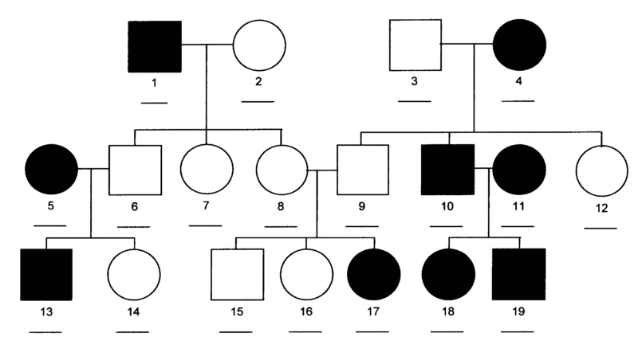
Address relatedness among individual
Methods to control for kinship
Identity by descent (IBD)
You can also estimate kinship: Identity by state (IBS)
  Loiselle et al. (1995)
  VanRaden (2008)
Notes:
Pedegree information, most for animal studies

Slide 23


GWAS software
User friendly: TASSEL
Versatile and pretty output: GAPIT
Can accommodate large dataset: PLINK

Slide 24
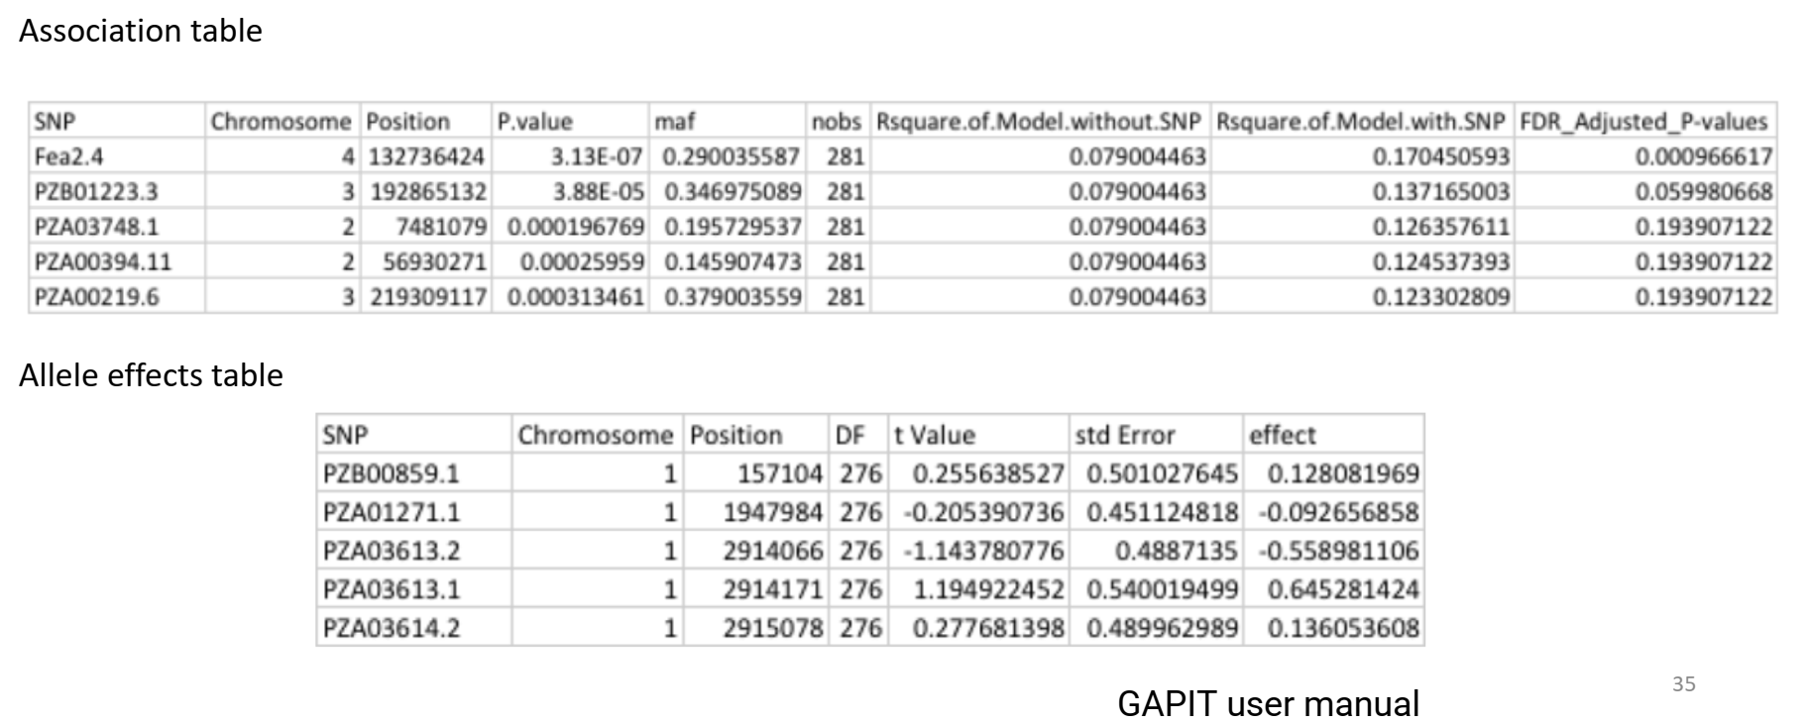
Interpret GWAS result
Notes:
Typical output of GWAS. Some model will calculate the allele effect

Slide 25

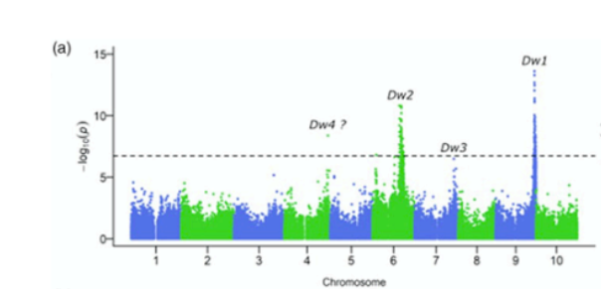
Interpret GWAS result
Manhattan Plot
Scatter plot used to display large number of data points and their significance in GWAS
Each data point is a SNP
X-axis: genomic position
Y-axis: negative logarithm of the association p-value
Cortes et al. (2020)
Notes:
Manhattan plot. Originally name after skyscraper.
Each datapoint is SNP marker, the higher it goes, the most significant association is

Slide 26
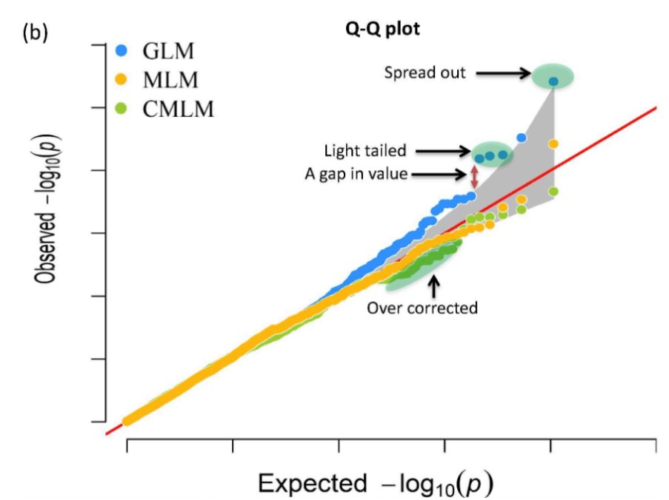
Interpret GWAS result
Q-Q plot (quantile-quantile plot)
An essential tool for detecting problems in GWAS
Alqudah et al. (2020)
Notes:
Ranked the p value from largest to smalle, check the distribution null distribution.
You want it to be red.
Yellow light, no significant threshold
Blue dot, there is some association.

Slide 27
Interpret GWAS results
How to decide on a cut-off for determining which p-values are significant
Multiple testing problem
  If type I error were set to a level (e.g. 0.05): The probability of incorrectly rejecting the null hypothesis
  If you are testing 1 million SNP, you are expected to incorrectly reject the hypothesis ~50,000 times

Slide 28
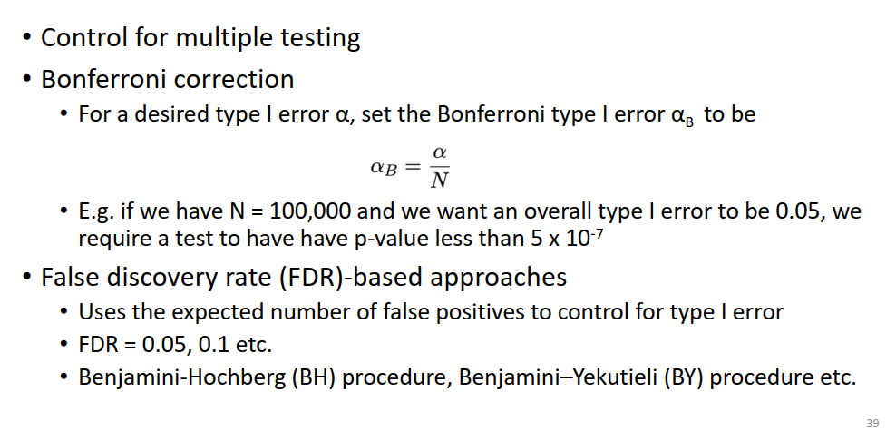
Interpret GWAS results
Control for multiple testing
Bonferroni correction
For a desired type I error
Notes:
Bonferroni correction: usually consider overally stringent,
Alpha level, divided by the number of test. The markers, the smaller p value you will get
Alternative: False discovery rate.
The FDR calculation involves estimating the proportion of false positives among the set of significant results, based on the assumption that some of the significant results are likely to be false positives. The FDR is the expected proportion of false positives among the set of significant results, and it is usually reported as a percentage or a ratio.

Slide 29
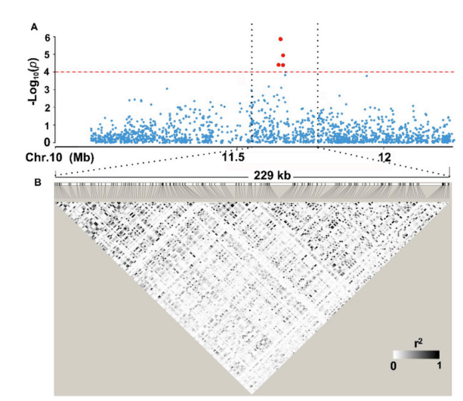
Interpretation of GWAS output
Search for candidate genes using local LD
Multiple candidate genes in the genomic region found by GWAS
  Look at expression pattern (WheatExpression)
  Functions of orthologous genes (Knetminer)
  Transgenic
  TILLING
Yang et al 2020
Notes:
Typically I like to look at the local LD pattern after identify an association.
So you can see that within your population, how big of a genomic region is passed down together along with your marker. 1Mbp or bigger, than you can look for your candidate genes within this region.
There are other genomic tools that might help you narrow down the candidate genes that we will cover today.

Slide 30
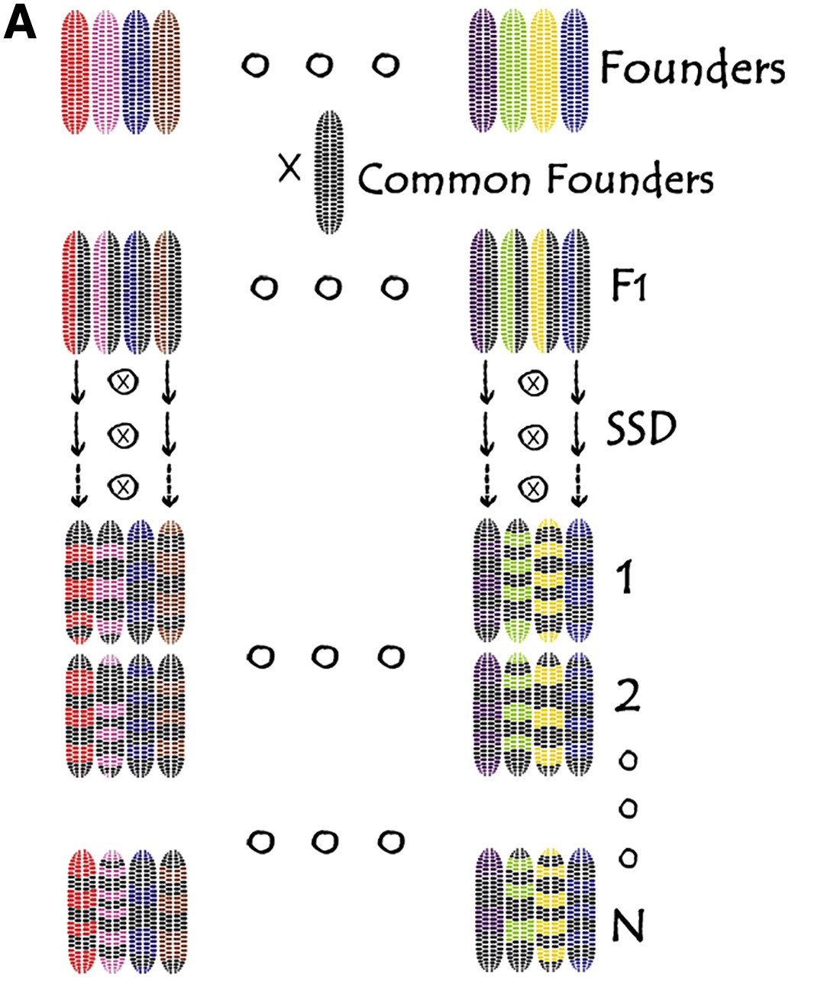
Other type of population: NAM
Combine the advantage of both linkage mapping and association mapping
Increase frequency of rare alleles
Rich allele diversity
High mapping resolution
Low marker density
Disadvantage:
Takes time and can be expensive to develop
Xiao et al 2017
Notes:
NAM: (nest association mapping)
You can potentially get artificial population structure where the QTL segregate among the RIL not within the RIL

Slide 31

Thank you!
Online GWAS workshop: AG2PI Workshop #4 A Practical Guide to Genome-Wide Association Studies (GWAS) by Zihao Zhang
https://www.youtube.com/watch?v=nrbgly0Bcv8&t=402s
Dr. Luzie Wingen

