Slide 1
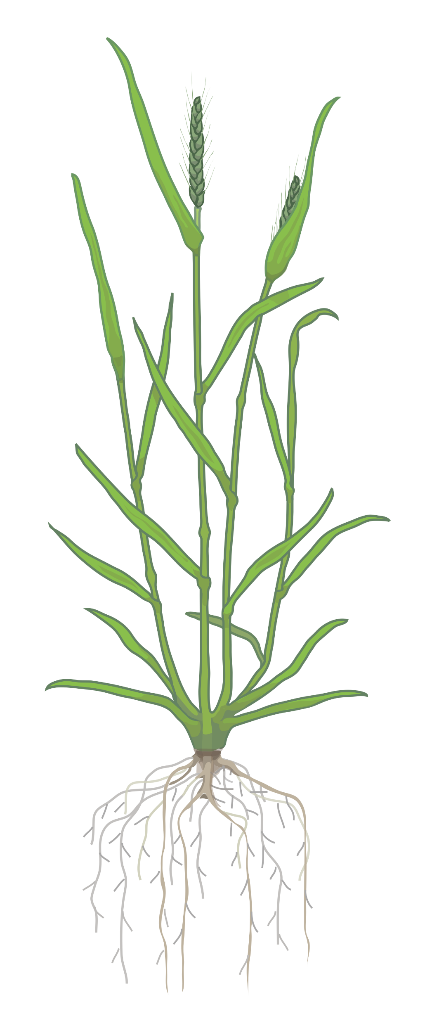
Session 03
An Introduction on how to use the Ensembl Plants database

Slide 2

A few key features about Ensembl Plants
http://www.plants.ensembl.org
currently 157 species represented
Ensembl Plants integrates data from other sources
  e.g. TAIR (Arabidopsis thaliana)
  EI / IWGSC (Triticum aestivum)
powerful database (albeit sometimes clunky interface)
continually updated (every 3-4 months; currently release 60)
Alignment, gene trees and homologs
Variant display and Variant Effect Predictor (VEP) tool
Display of user data
Data export via BioMart
Programmatic access via the APIs
Completely open-source (FTP, Github)
Thanks to Jorge Batista da Rocha, Sarah Dyer and the Ensembl Team for concepts and points presented in the slides

Slide 3
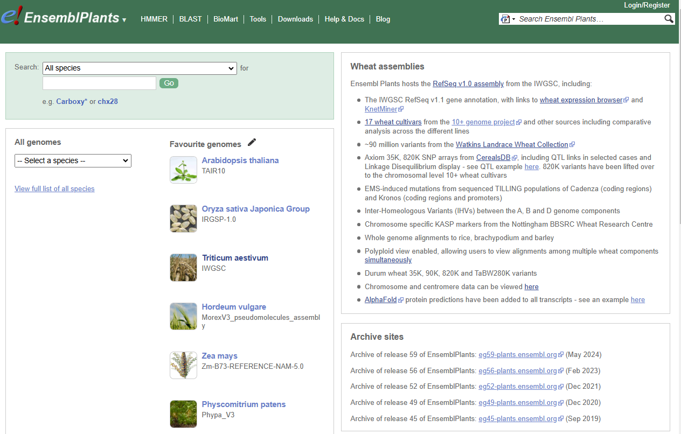

Slide 4
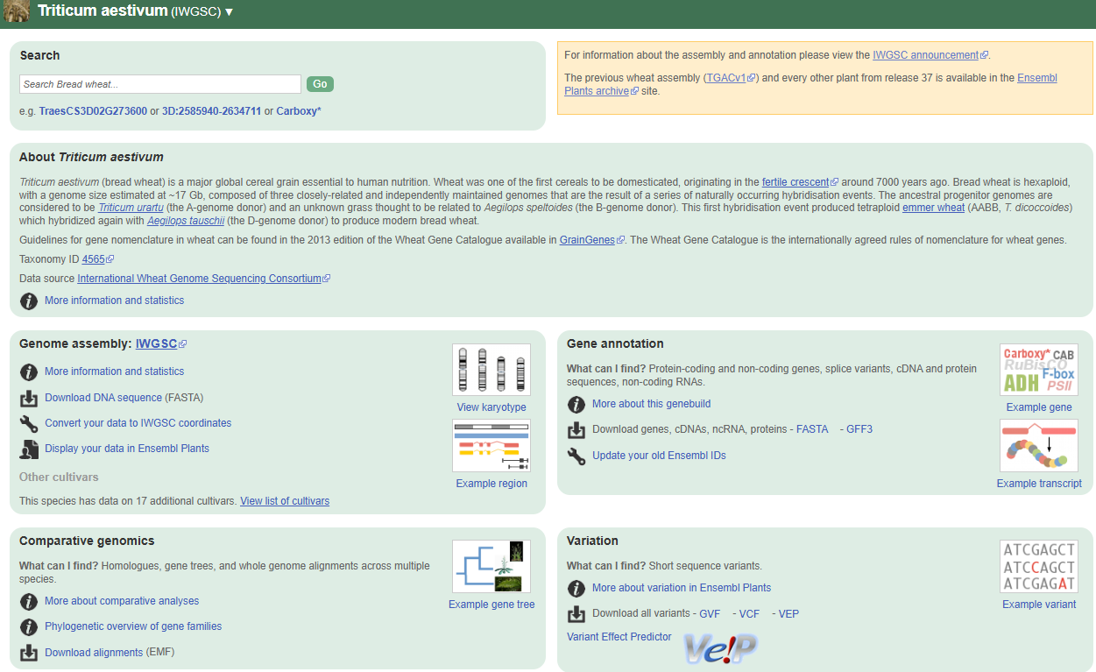

Slide 5
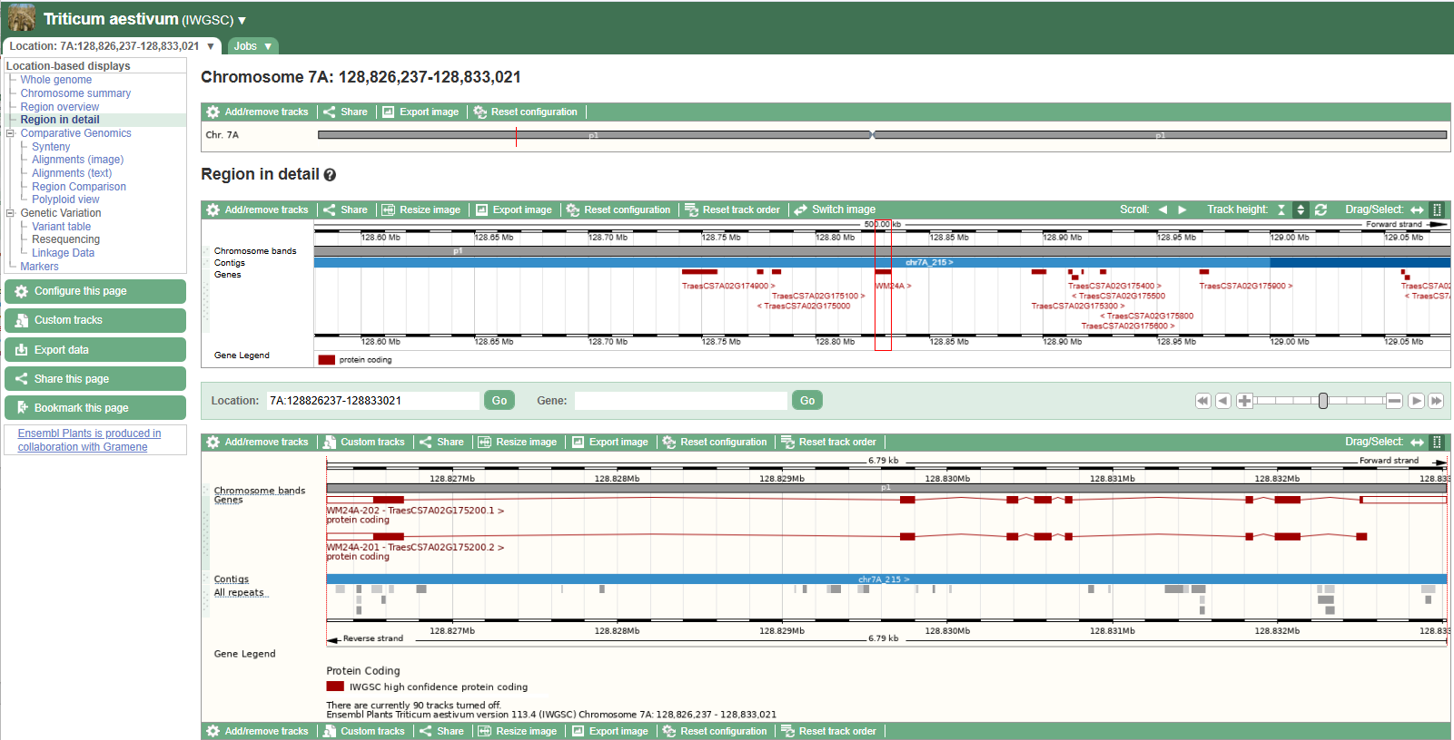
Initial basic view of a specific genomic interval (7A:128826237-128833021)
Position on chromosome
Genes and annotations in wider region
(0.5 Mbp)
Detailed region (gene level)
(7 kbp)

Slide 6
Initial basic view of a specific genomic interval (7A:128826237-128833021)

Slide 7
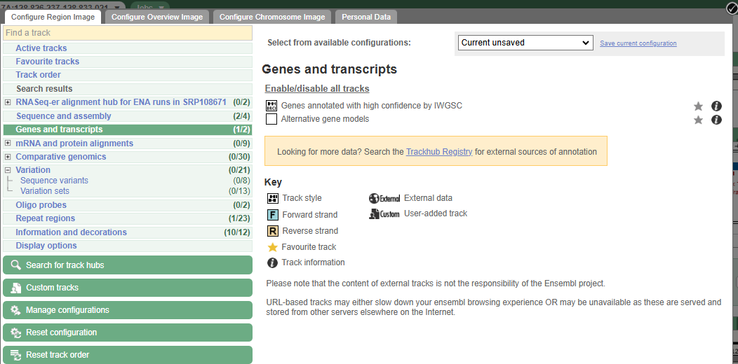

Slide 8
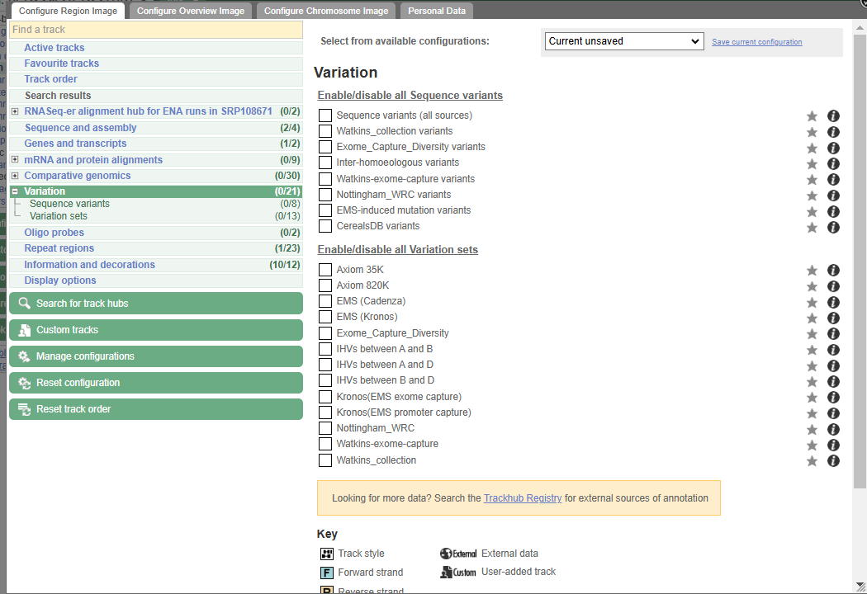
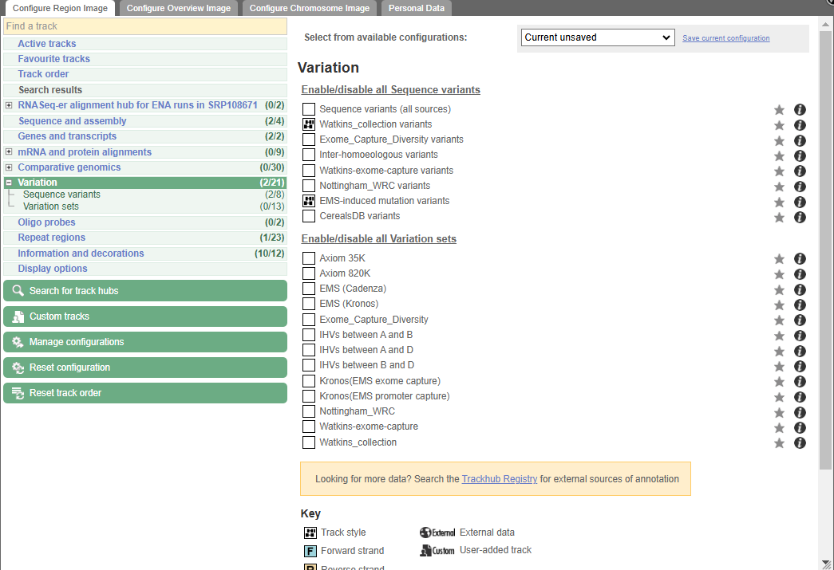
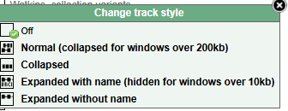

Slide 9
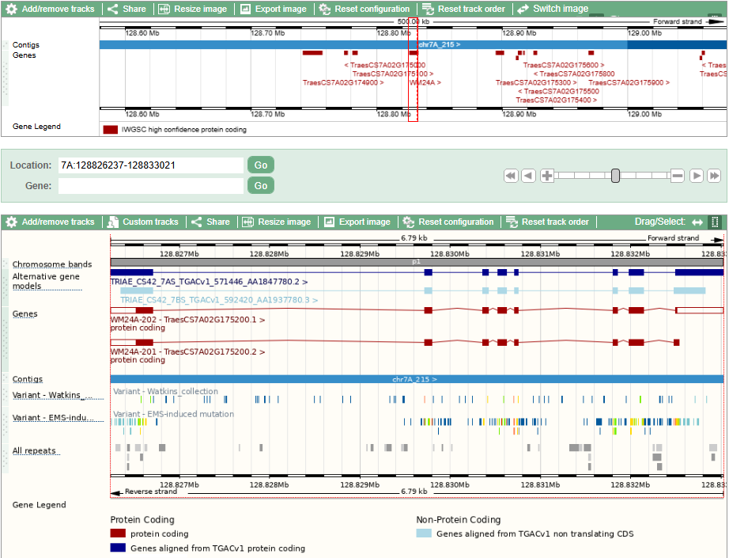
Alternative gene models (TGAC and LC)
Watkins Variations
EMS mutations

Slide 11
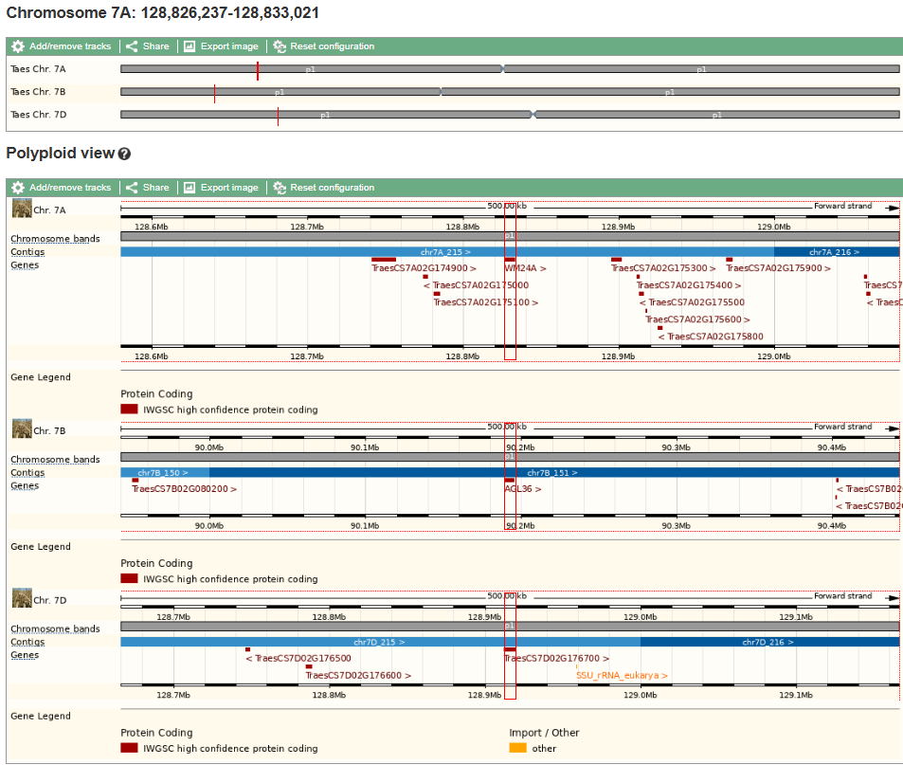
Genes and annotations in wider region
(0.5 Mbp)

Slide 12
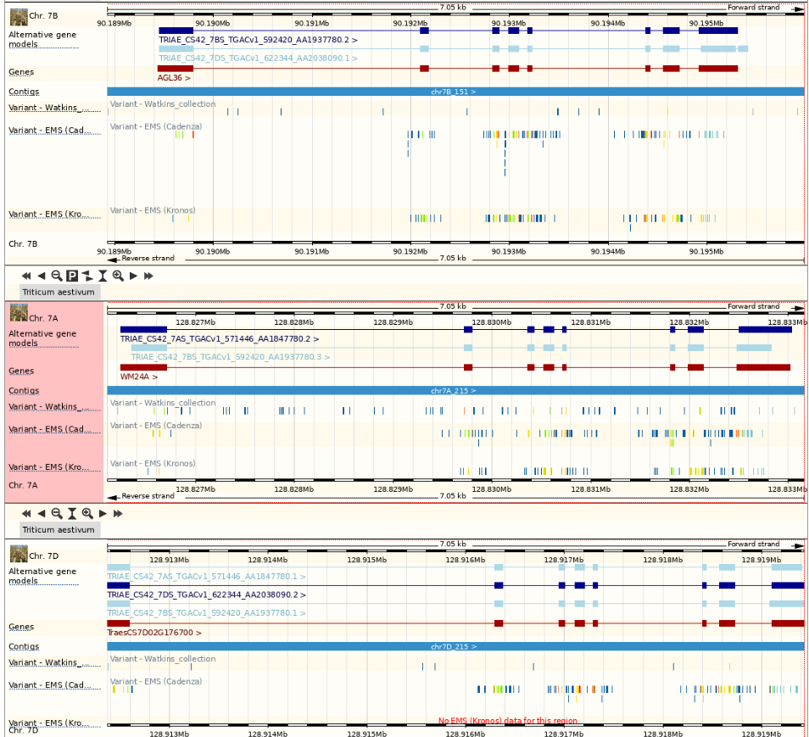
Scrolling down
Detailed region (gene level)
(7 kbp)

Slide 13
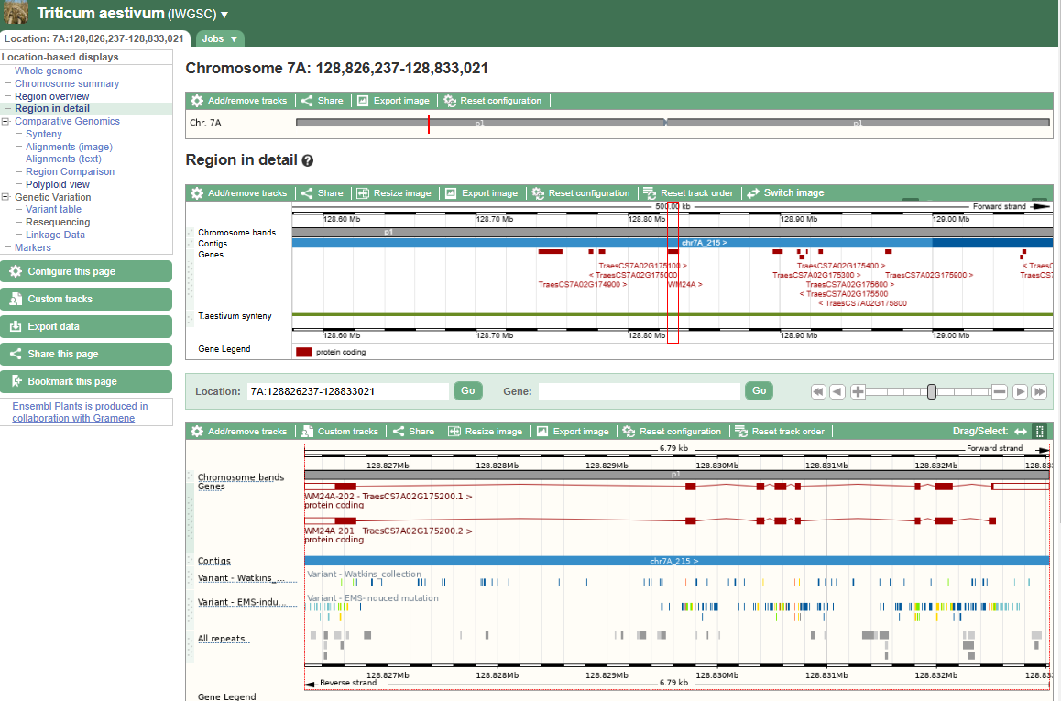
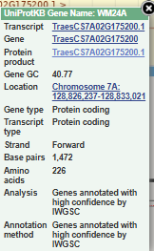
Back to general region overview... Let’s go into a gene

Slide 14
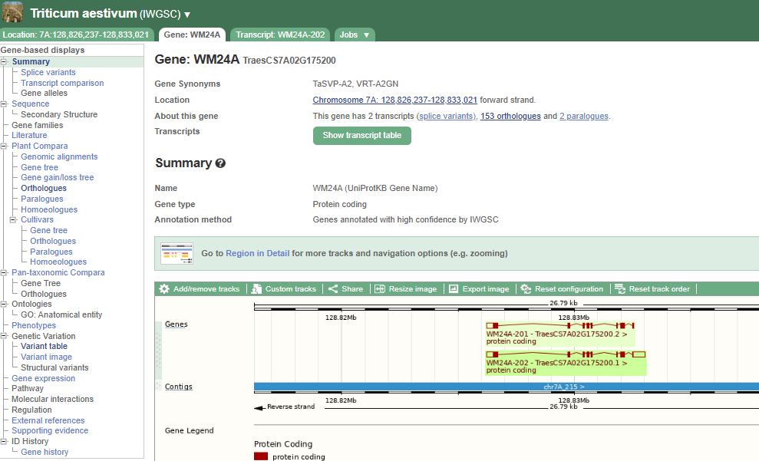
Wider region tab still available
New tabs appear
Gene-based displays

Slide 16
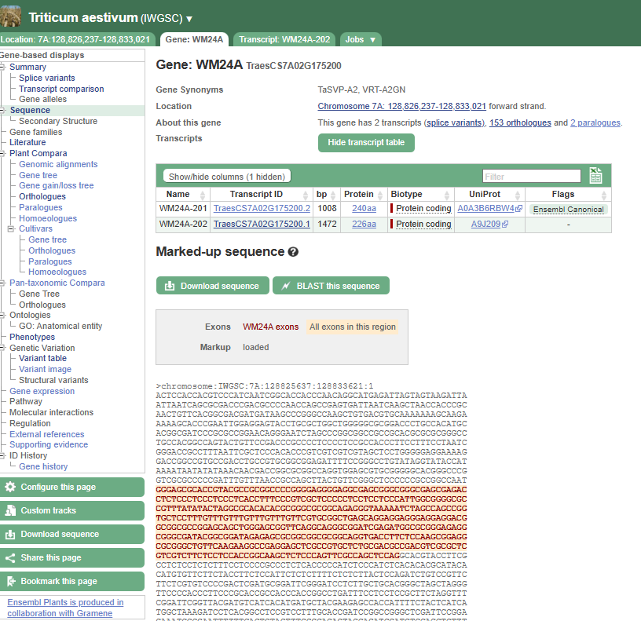
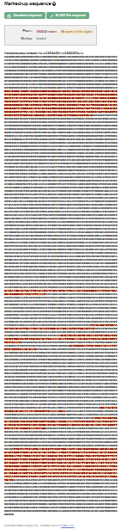
Zooming out

Slide 17
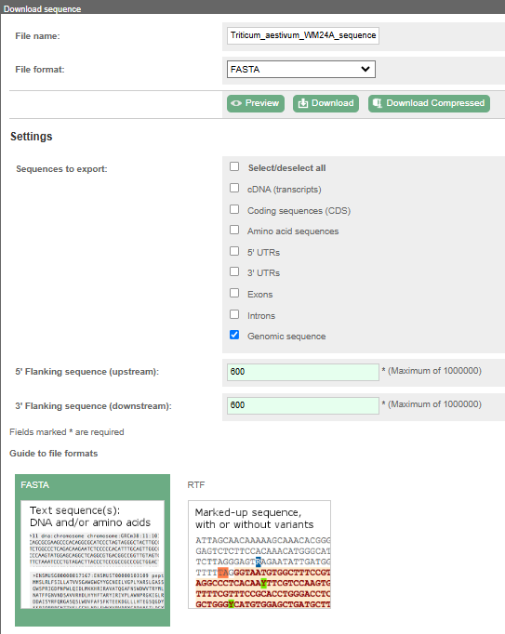

Slide 18
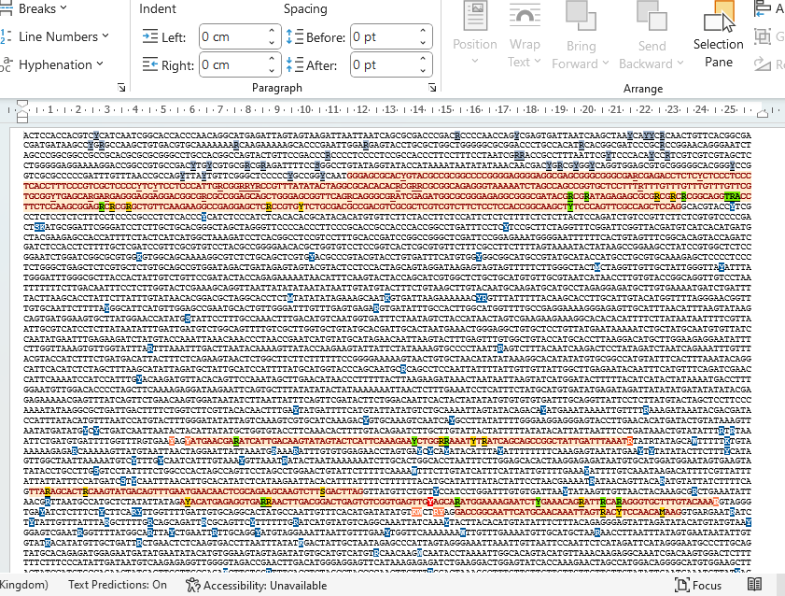

Slide 19
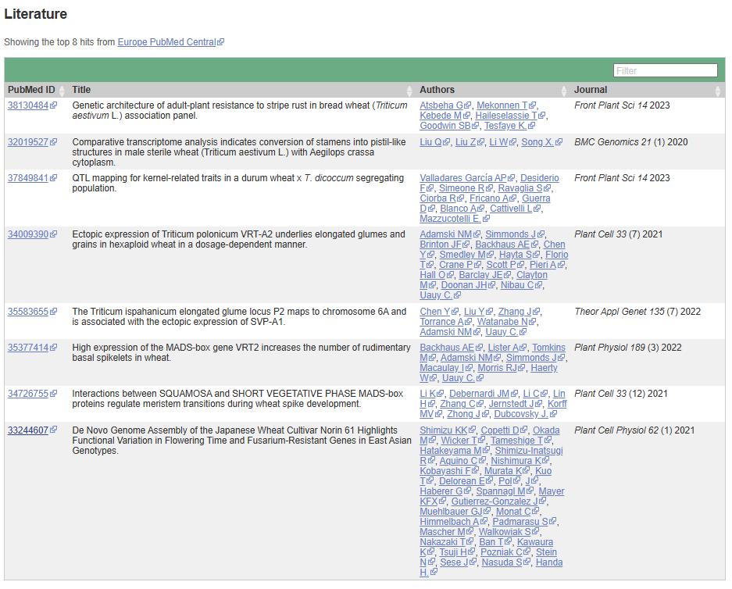

Slide 21
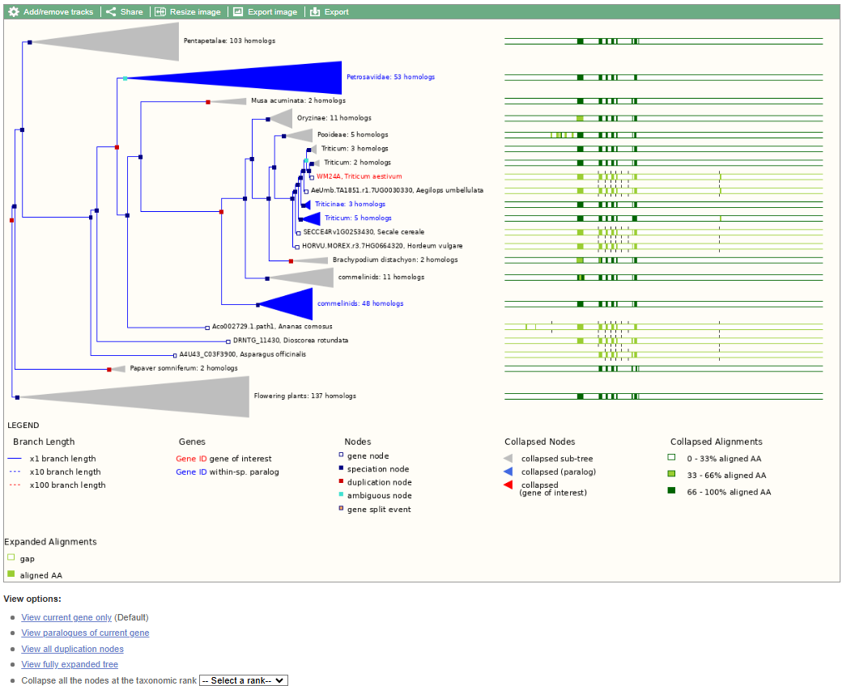

Slide 22
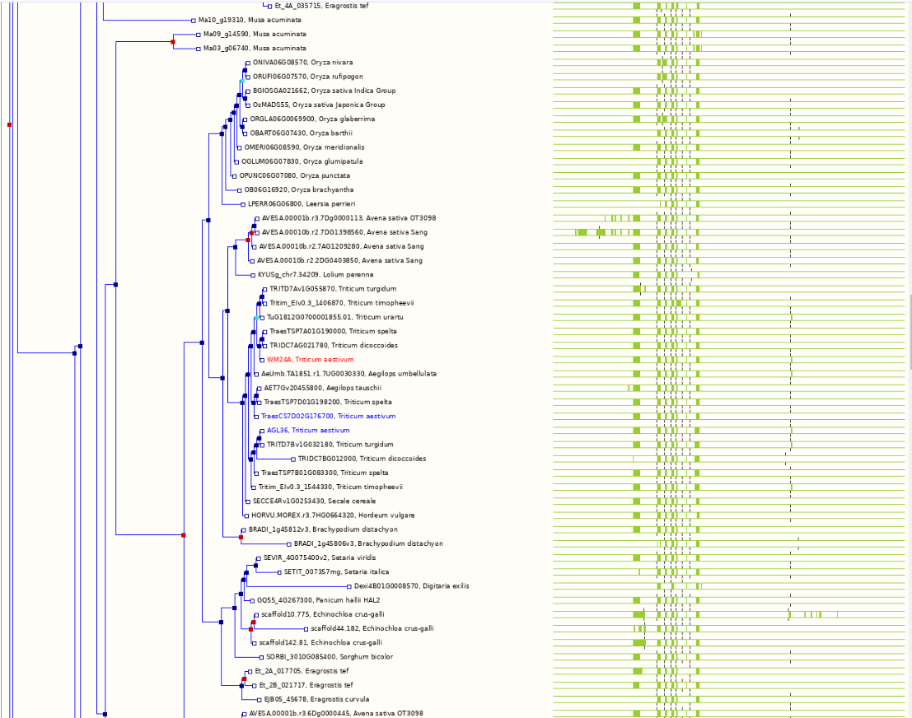
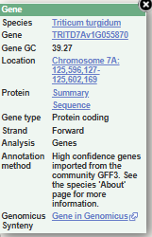

Slide 23
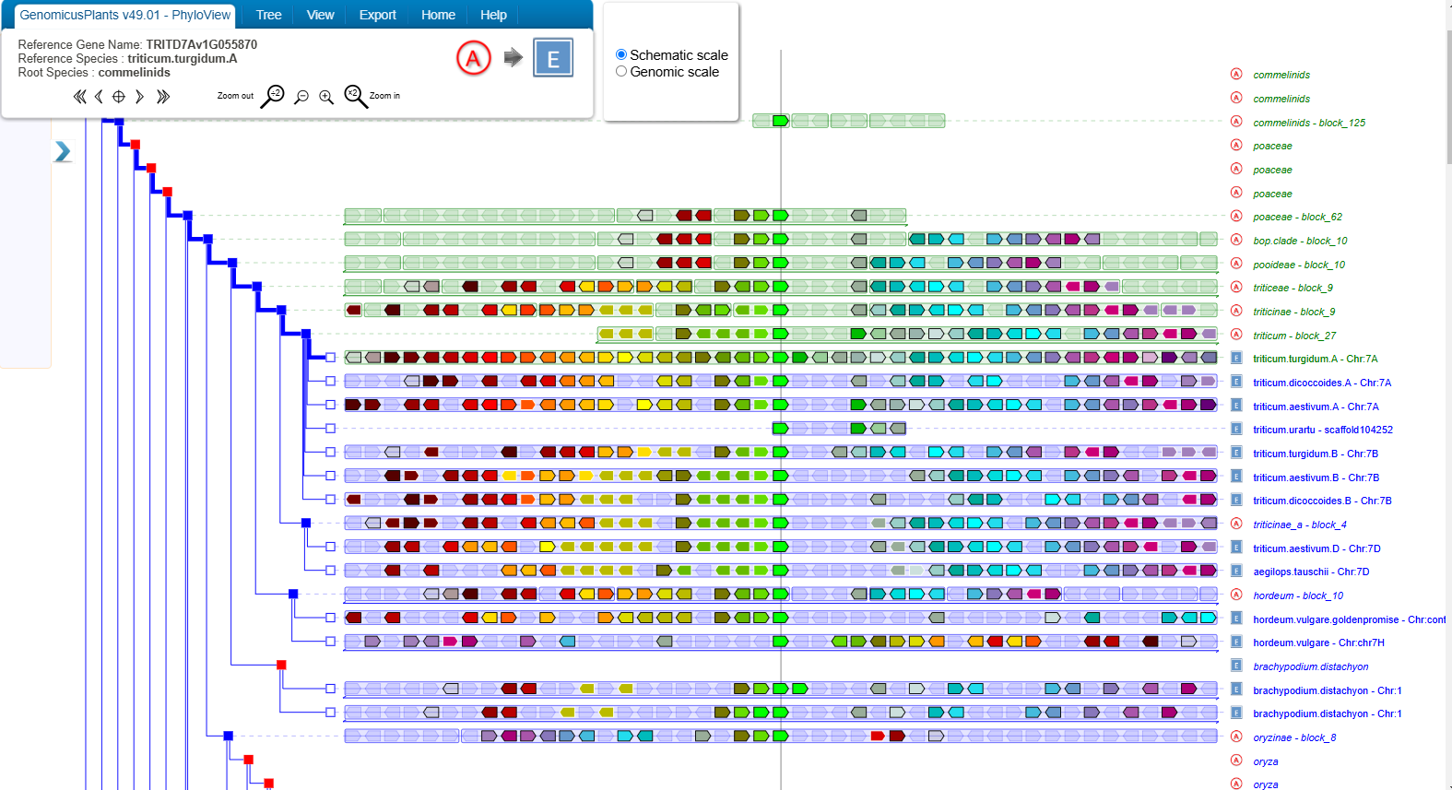

Slide 24
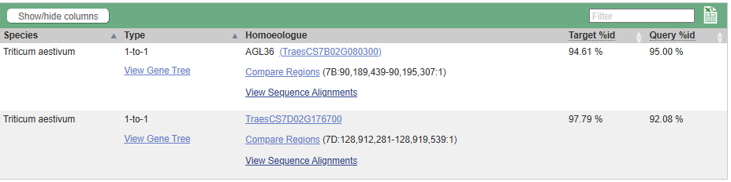

Slide 25
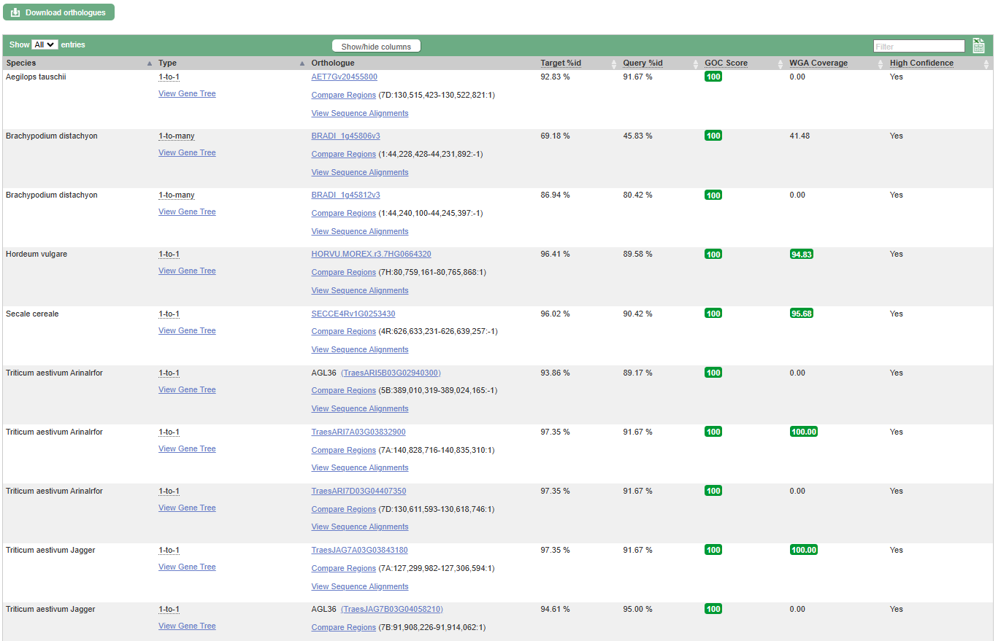

Slide 26
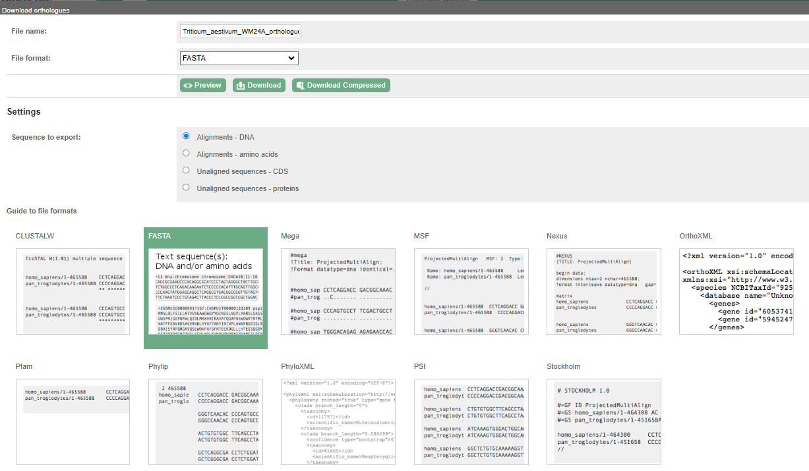

Slide 28
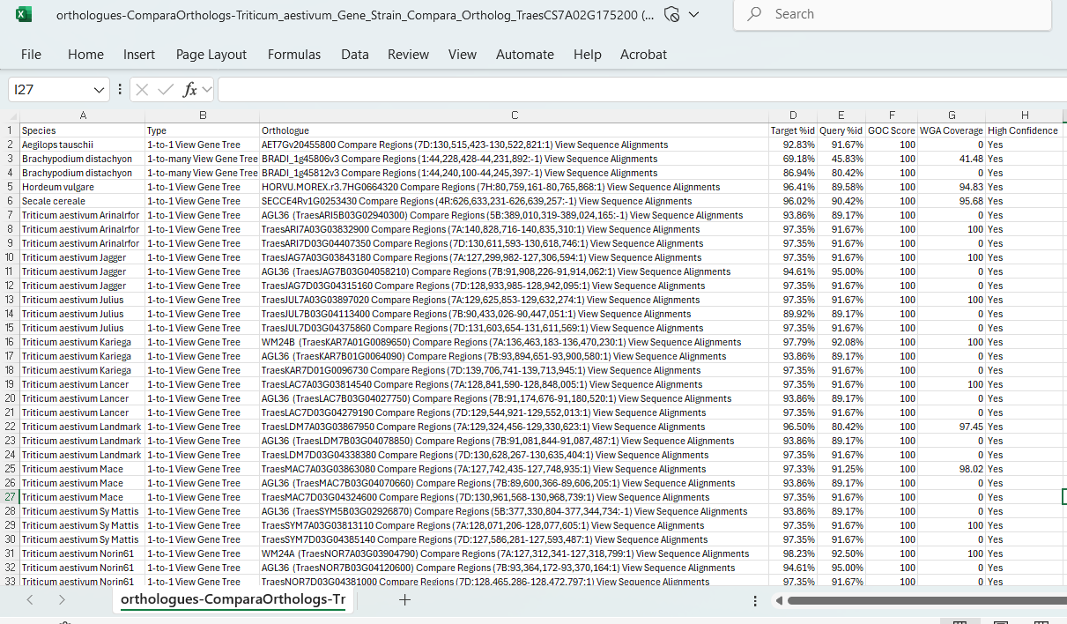

Slide 30
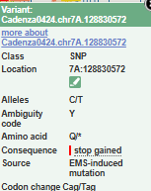
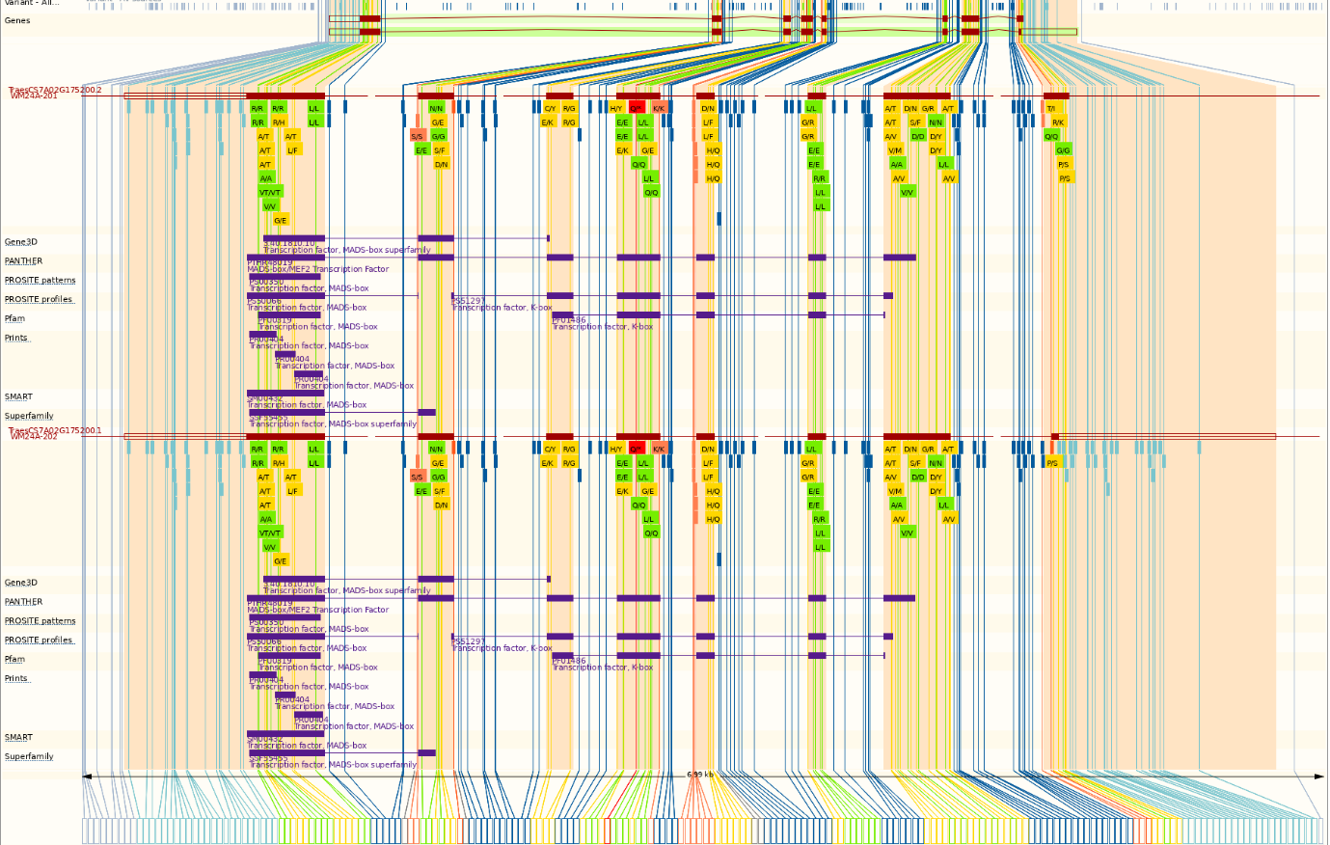

Slide 31
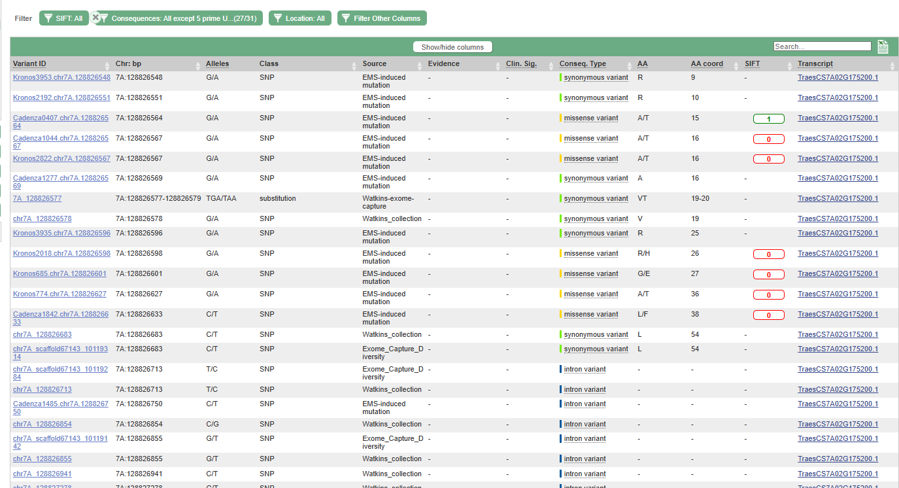

Slide 32
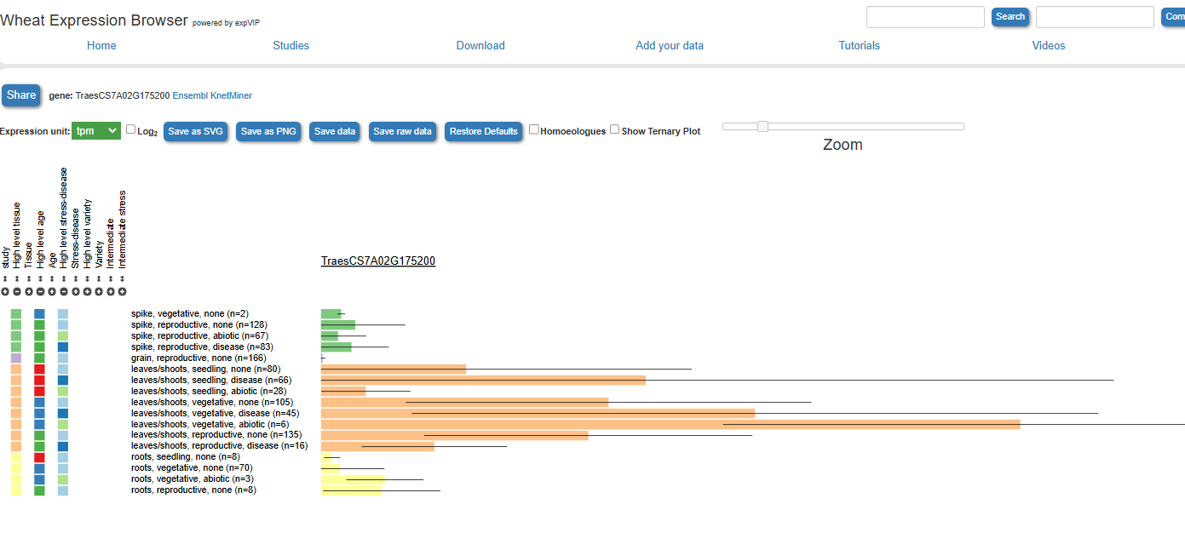
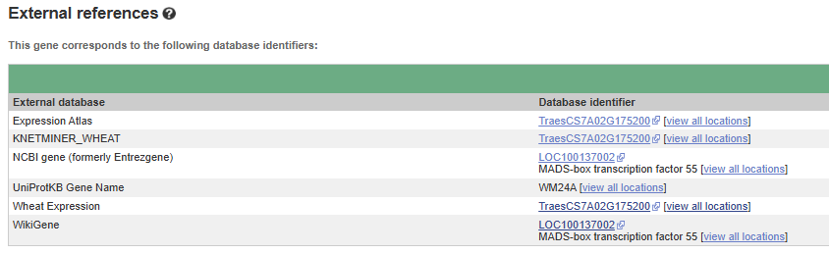

Slide 33
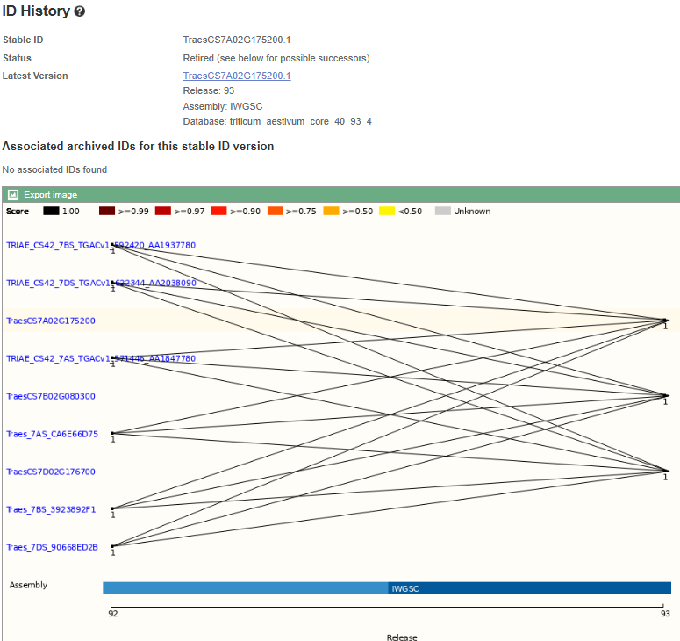

Slide 34
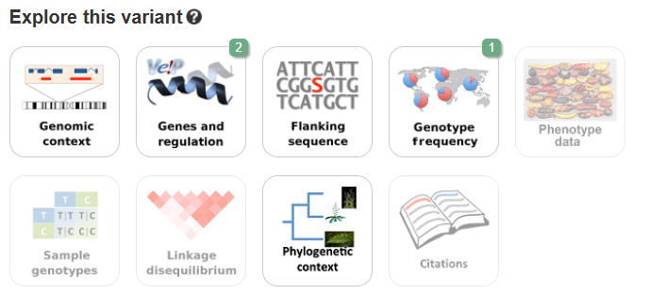
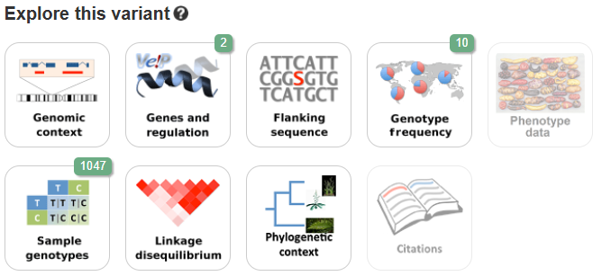
Back to variations...

Slide 35
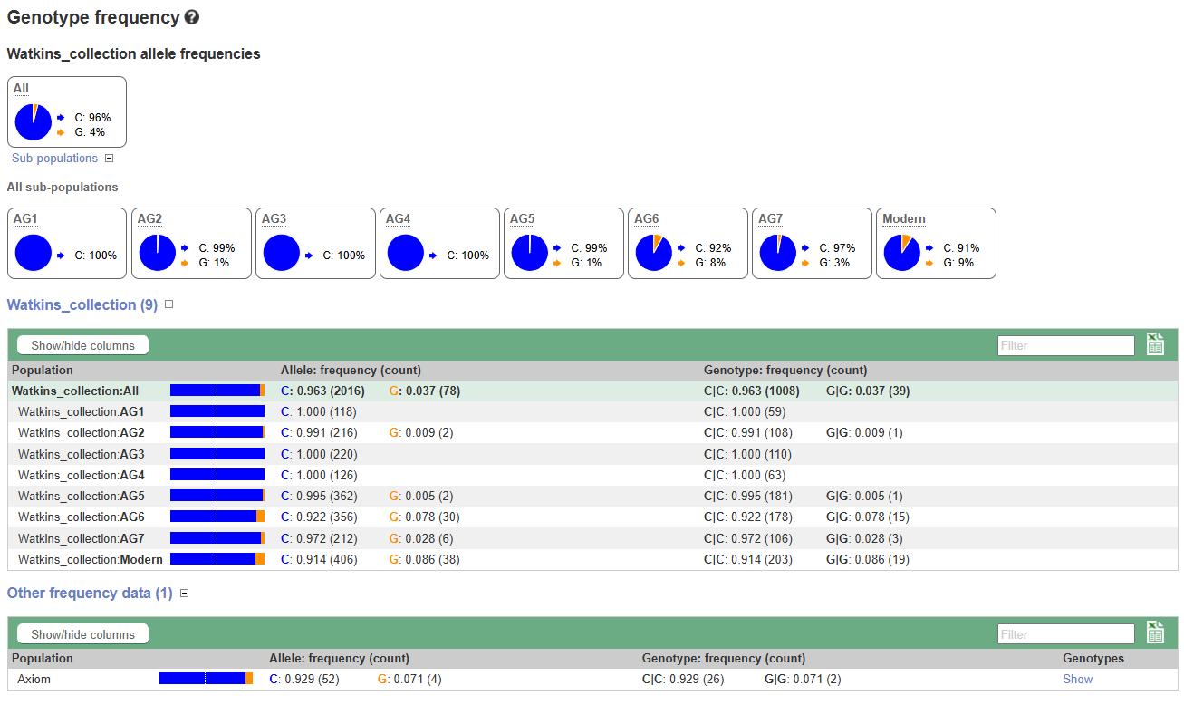

Slide 36
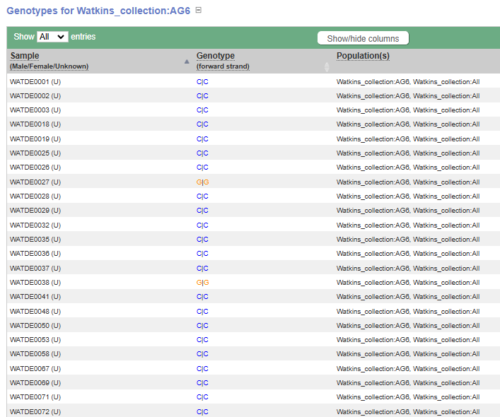
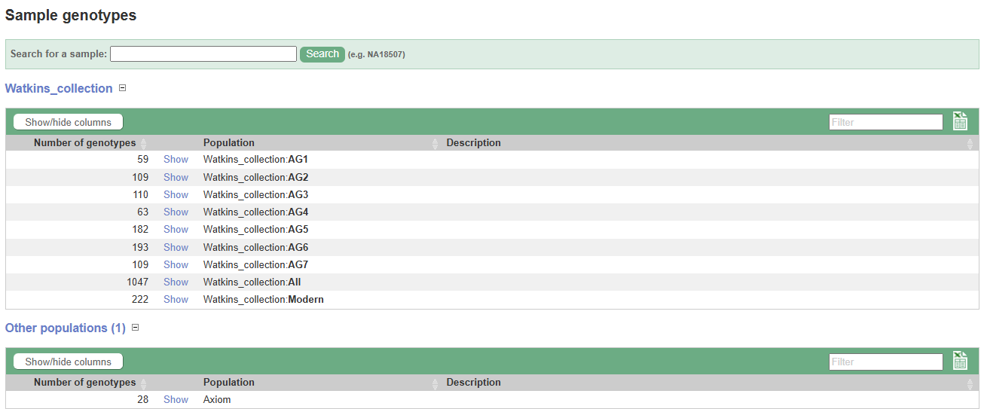

Slide 37
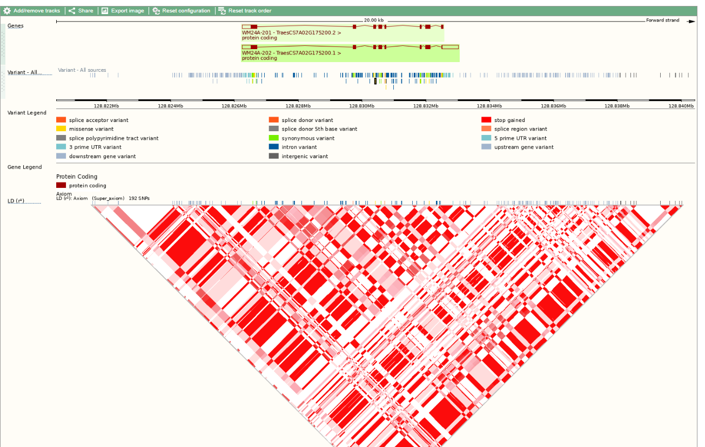

Slide 38
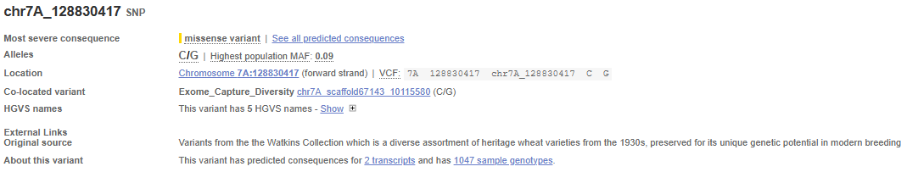
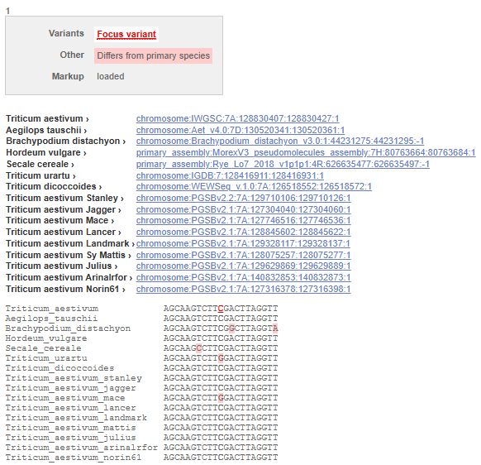

Slide 39
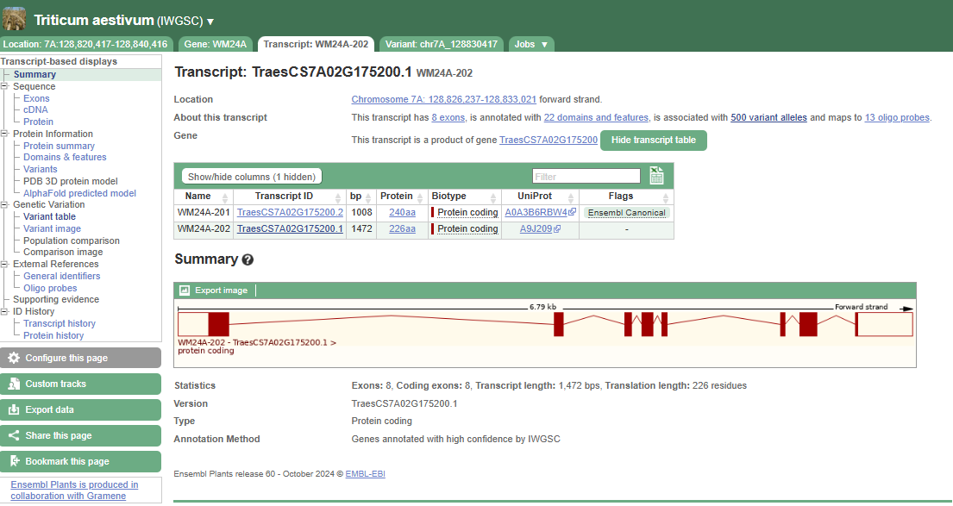
Wider region tab still available
Transcript tab
transcript-based displays

Slide 40
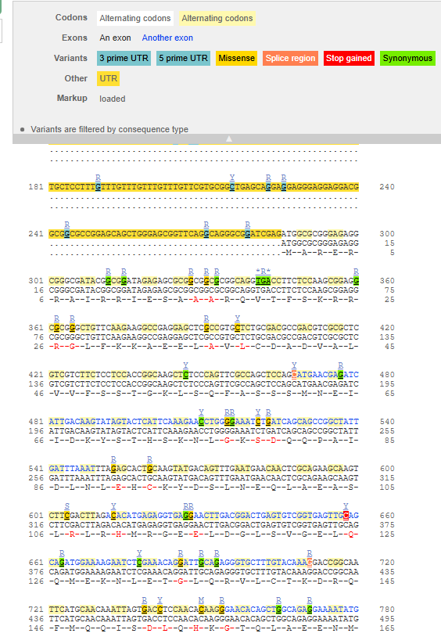
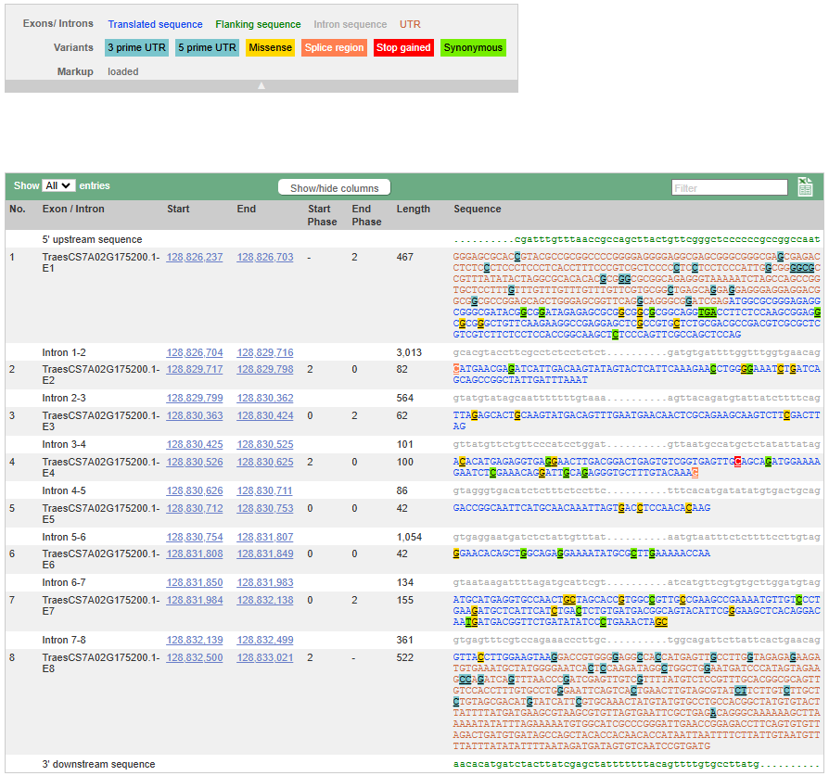
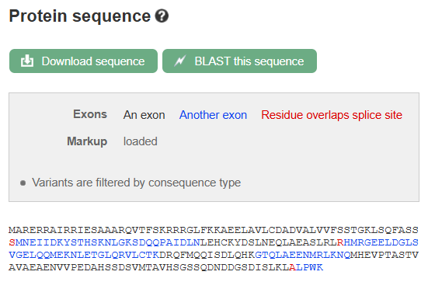

Slide 41
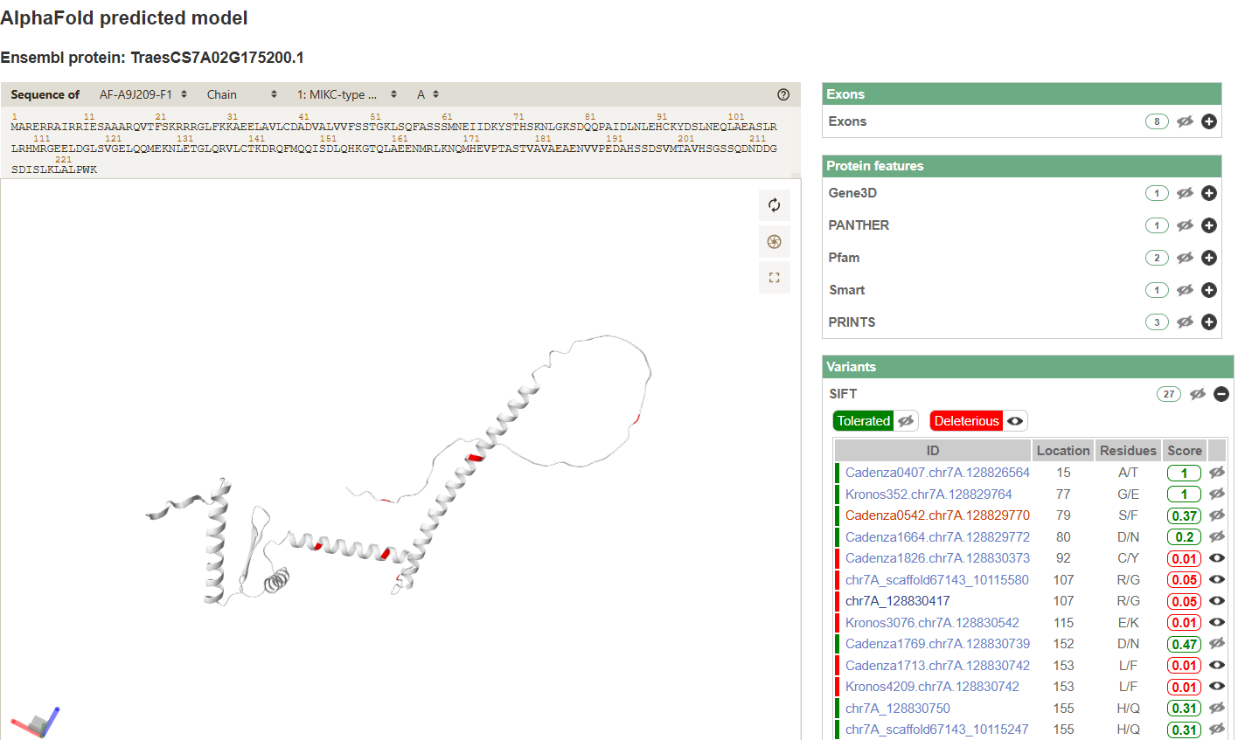

Slide 42
BioMart
For things that would be time consuming and / or difficult with the Ensembl browser.
A tool in your browser:
  Export Ensembl data
  No programming knowledge required
  Build queries with a few mouse clicks
  Generates customisable data tables and files
https://plants.ensembl.org/biomart/martview/
Why use BioMart
  Query multiple things (gene / variants) at once:
    gene locations
    download sequences
  Export large amounts of data
Thanks to Jorge Batista da Rocha, Sarah Dyer and the Ensembl Team for concepts and points presented in the slides

Slide 44
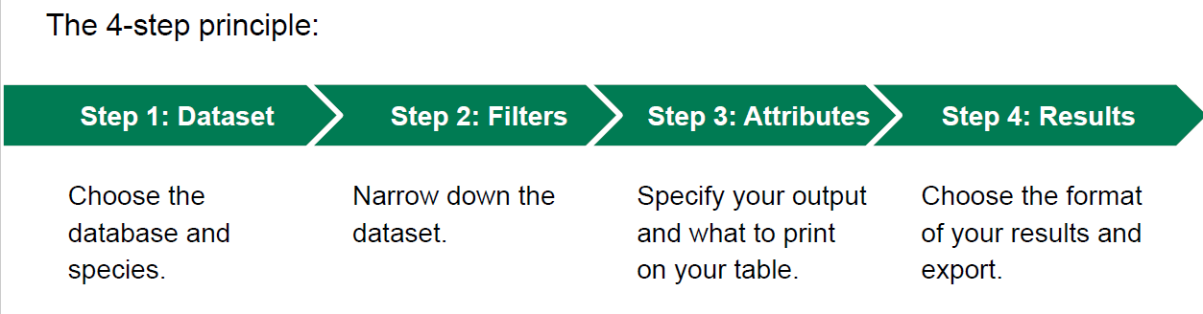

Slide 45
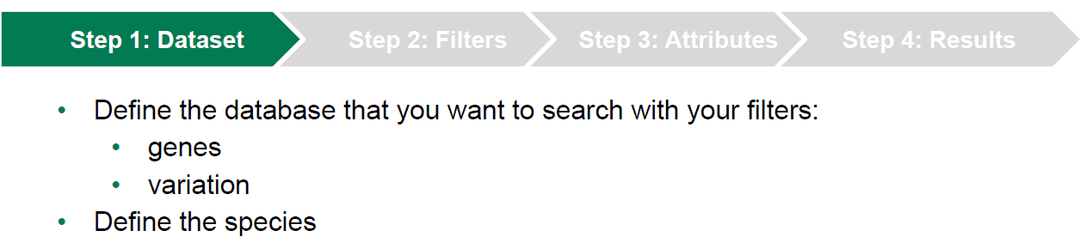
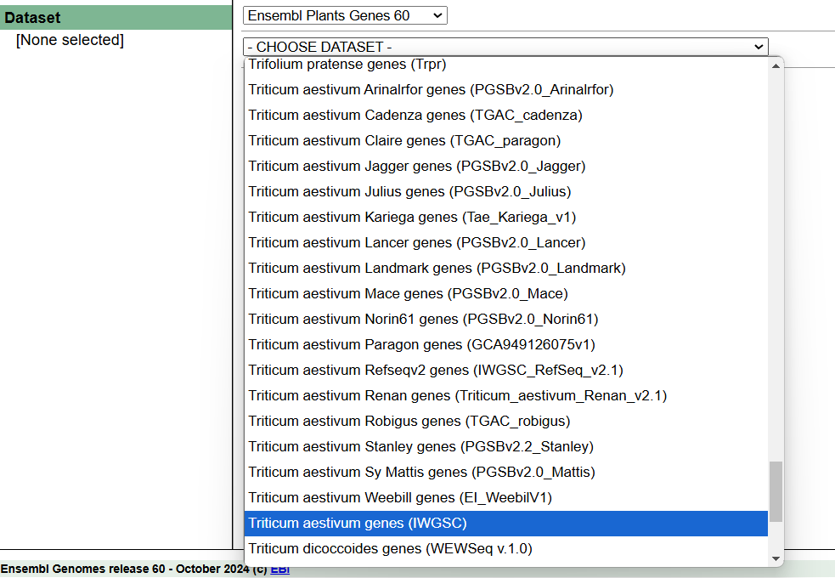
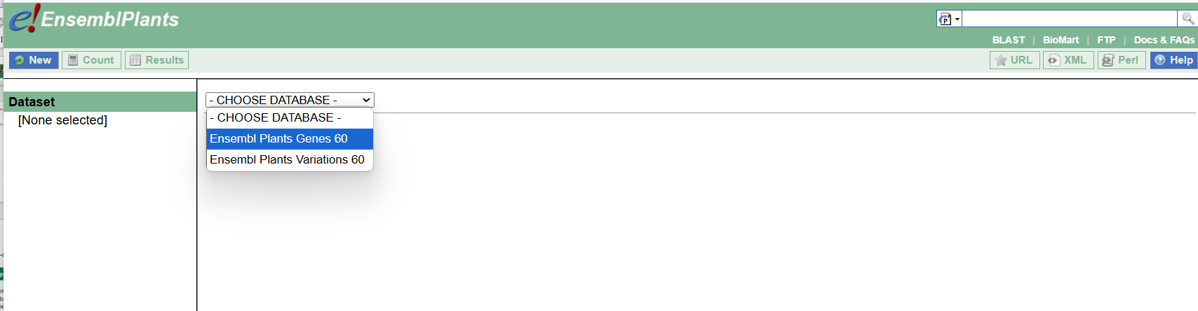

Slide 46


Slide 47



Slide 48


Slide 49
Possible queries:
Finding genes within a QTL interval
Downloading sequence for all genes with a specific GO term or Pfam domain
Get all rice orthologs for a set of wheat genes
Get GO annotation for a set of wheat genes (e.g. differentially expressed genes)

Slide 50

Finding genes within a QTL interval (e.g. chr7A 20-30 Mbp)

Slide 51



Finding genes within a QTL interval (e.g. chr7A 20-30 Mbp)

Slide 52


Slide 53

Finding gene (sequences) within a QTL interval (e.g. chr7A 20-30 Mbp)

Slide 54

Finding gene (IDs) within a QTL interval (e.g. chr7A 20-30 Mbp)

Slide 55
Possible queries:
Finding genes within a QTL interval
Downloading sequence for all genes with a specific GO term or Pfam domain
Get all rice orthologs for a set of wheat genes
Get GO annotation for a set of wheat genes (e.g. differentially expressed genes)

Slide 56

R package for BioMart
http://www.bioconductor.org/packages/release/bioc/vignettes/biomaRt/inst/doc/biomaRt.pdf
https://www.ensembl.org/info/data/biomart/biomart_r_package.html

