Slide 1
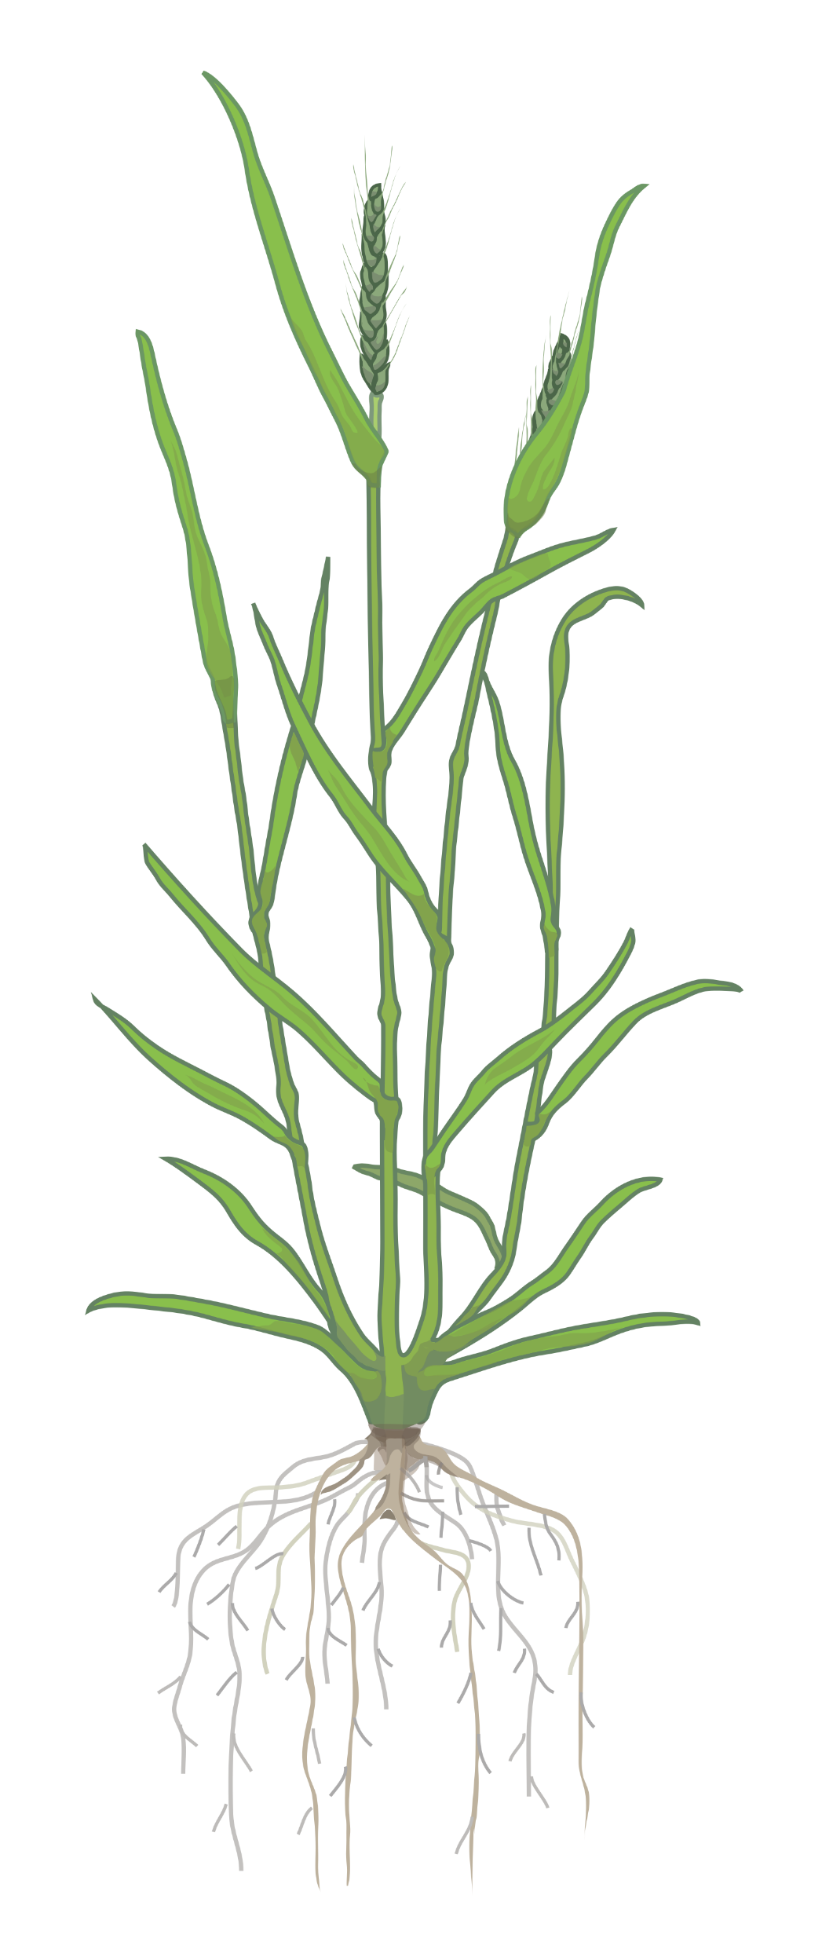
Session 02
Wheat Genomic Resources

Slide 2
An update on the current state of wheat genomics
Update on Reference genome assemblies and gene model annotations available for wheat

Slide 3
The Challenge of the Wheat Genome
Large genome size
(~16,000 Mb vs rice ~400 Mb)
Arabidopsis
thaliana
Rice
Human
Wheat

Slide 4
The Challenge of the Wheat Genome
Large genome size
(~16,000 Mb vs rice ~400 Mb)
A
Allopolyploid of 3 diploid species (hexaploid)
→ 3 copies of each gene
B
85% of genome consists of repetitive elements (DNA and retrotransposons)
D
Wheat

Slide 5
A brief recap on gene homology
Homoeologs
Triticum aestivum (wheat)
1
2
3
4
5
6
7
Genes from similar chromosomes brought together through inter-species hybridization and allopolyploidisation
VRT-A2
A
VRT-B2
B
VRT-D2
D

Slide 6
A brief recap on gene homology
Orthologs
Triticum aestivum (wheat)
1
2
3
4
5
6
7
Genes in different species that evolved from a common ancestor
VRT-A2
A
Oryza sativa (rice)
1
2
3
4
5
6
7
8
9
10
11
12
VRT-B2
B
Os06g0217300
VRT-D2
D

Slide 7
A brief recap on gene homology
Paralogs
Triticum aestivum (wheat)
1
2
3
4
SEP1-A3-1
5
6
7
Genes resulting from duplication events within one species
A
SEP1-A3-2
SEP1-B3-1
B
SEP1-D3-1
D

Slide 8



3 generations of wheat genome assemblies
 | CSS | TGACv1 | RefSeqv1.0
Release date | IWGSC, 2014 | Clavijo et al., 2017 | IWGSC, 2018

Slide 9
Chinese Spring Survey Sequence (CSS)
 | CSS | TGACv1 | RefSeqv1.0
Release date | IWGSC, 2014 | Clavijo et al., 2017 | IWGSC, 2018
# contigs/ chromosomes | > 1 million | 735,943 | 21 chromosomes + Un
Mean scaffold size | 7.7 kb | 88.7 kb | Chromosomes
Assembly Size | 10.2 Gb | 13.4 Gb | 14.6 Gb
Order | Crude order | Large Bins | “True” physical order
Gene names | Traes_1BL_447468BDE | TRIAE_CS42_7DL_TGACv1_731555_AA2173560 | TraesCS2B01G000100 TraesCS4B01G000400LC

Slide 10
Chinese Spring Survey Sequence (CSS)
 | CSS | TGACv1 | RefSeqv1.0
Release date | IWGSC, 2014 | Clavijo et al., 2017 | IWGSC, 2018
# contigs/ chromosomes | > 1 million | 735,943 | 21 chromosomes + Un
Mean scaffold size | 7.7 kb | 88.7 kb | Chromosomes
Assembly Size | 10.2 Gb | 13.4 Gb | 14.6 Gb
Order | Crude order | Large Bins | “True” physical order
Gene names | Traes_1BL_447468BDE | TRIAE_CS42_7DL_TGACv1_731555_AA2173560 | TraesCS2B01G000100 TraesCS4B01G000400LC
Species designation:
Triticum aestivum
Unique ID
(no positional information)
Traes_1BL_447468BDE
Chromosome arm

Slide 11

Chinese Spring Survey Sequence (CSS)
 | CSS | TGACv1 | RefSeqv1.0
Release date | IWGSC, 2014 | Clavijo et al., 2017 | IWGSC, 2018
# contigs/ chromosomes | > 1 million | 735,943 | 21 chromosomes + Un
Mean scaffold size | 7.7 kb | 88.7 kb | Chromosomes
Assembly Size | 10.2 Gb | 13.4 Gb | 14.6 Gb
Order | Crude order | Large Bins | “True” physical order
Gene names | Traes_1BL_447468BDE | TRIAE_CS42_7DL_TGACv1_731555_AA2173560 | TraesCS2B01G000100 TraesCS4B01G000400LC
Traes_1BL_447468BDE
Separate annotation for chromosome 3B
TRAES3BF021600020CFD_t1

Slide 12
TGACv1 genome assembly
 | CSS | TGACv1 | RefSeqv1.0
Release date | IWGSC, 2014 | Clavijo et al., 2017 | IWGSC, 2018
# contigs/ chromosomes | > 1 million | 735,943 | 21 chromosomes + Un
Mean scaffold size | 7.7 kb | 88.7 kb | Chromosomes
Assembly Size | 10.2 Gb | 13.4 Gb | 14.6 Gb
Order | Crude order | Large Bins | “True” physical order
Gene names | Traes_1BL_447468BDE | TRIAE_CS42_7DL_TGACv1_731555_AA2173560 | TraesCS2B01G000100 TraesCS4B01G000400LC

Slide 13
TGACv1 genome assembly
 | CSS | TGACv1 | RefSeqv1.0
Release date | IWGSC, 2014 | Clavijo et al., 2017 | IWGSC, 2018
# contigs/ chromosomes | > 1 million | 735,943 | 21 chromosomes + Un
Mean scaffold size | 7.7 kb | 88.7 kb | Chromosomes
Assembly Size | 10.2 Gb | 13.4 Gb | 14.6 Gb
Order | Crude order | Large Bins | “True” physical order
Gene names | Traes_1BL_447468BDE | TRIAE_CS42_7DL_TGACv1_731555_AA2173560 | TraesCS2B01G000100 TraesCS4B01G000400LC
Species: TRIticum AEstivum
Accession: Chinese Spring 42
Assembly
version
Gene number
TRIAE_CS42_7DL_TGACv1_731555_AA2173560
Chromosome arm
Scaffold number

Slide 14
TGACv1 genome assembly
 | CSS | TGACv1 | RefSeqv1.0
Release date | IWGSC, 2014 | Clavijo et al., 2017 | IWGSC, 2018
# contigs/ chromosomes | > 1 million | 735,943 | 21 chromosomes + Un
Mean scaffold size | 7.7 kb | 88.7 kb | Chromosomes
Assembly Size | 10.2 Gb | 13.4 Gb | 14.6 Gb
Order | Crude order | Large Bins | “True” physical order
Gene names | Traes_1BL_447468BDE | TRIAE_CS42_7DL_TGACv1_731555_AA2173560 | TraesCS2B01G000100 TraesCS4B01G000400LC
Gene
TRIAE_CS42_7DL_TGACv1_731555_AA2173560
Scaffold
TGACv1_scaffold_731555_7DL

Slide 15
RefSeqv1.0 genome assembly
 | CSS | TGACv1 | RefSeqv1.0
Release date | IWGSC, 2014 | Clavijo et al., 2017 | IWGSC, 2018
# contigs/ chromosomes | > 1 million | 735,943 | 21 ”chromosomes” + Un
Mean scaffold size | 7.7 kb | 88.7 kb | Pseudo chromosomes
Assembly Size | 10.2 Gb | 13.4 Gb | 14.6 Gb
Order | Crude order | Large Bins | “True” physical order
Gene names | Traes_1BL_447468BDE | TRIAE_CS42_7DL_TGACv1_731555_AA2173560 | TraesCS2B01G000100 TraesCS4B01G000400LC

Slide 16
RefSeqv1.0 genome assembly
 | CSS | TGACv1 | RefSeqv1.0
Release date | IWGSC, 2014 | Clavijo et al., 2017 | IWGSC, 2018
# contigs/ chromosomes | > 1 million | 735,943 | 21 ”chromosomes” + Un
Mean scaffold size | 7.7 kb | 88.7 kb | Pseudo chromosomes
Assembly Size | 10.2 Gb | 13.4 Gb | 14.6 Gb
Order | Crude order | Large Bins | “True” physical order
Gene names | Traes_1BL_447468BDE | TRIAE_CS42_7DL_TGACv1_731555_AA2173560 | TraesCS2B01G000100 TraesCS4B01G000400LC
Species: Triticum aestivum
Accession: Chinese Spring
Assembly
version
TraesCS2B01G000100
Chromosome
Gene number

Slide 17
RefSeqv1.0 genome assembly (low confidence)
 | CSS | TGACv1 | RefSeqv1.0
Release date | IWGSC, 2014 | Clavijo et al., 2017 | IWGSC, 2018
# contigs/ chromosomes | > 1 million | 735,943 | 21 ”chromosomes” + Un
Mean scaffold size | 7.7 kb | 88.7 kb | Pseudo chromosomes
Assembly Size | 10.2 Gb | 13.4 Gb | 14.6 Gb
Order | Crude order | Large Bins | “True” physical order
Gene names | Traes_1BL_447468BDE | TRIAE_CS42_7DL_TGACv1_731555_AA2173560 | TraesCS2B01G000100 TraesCS4B01G000400LC
Species: Triticum aestivum
Accession: Chinese Spring
Assembly
version
Low Confidence
TraesCS4B01G000400LC
Chromosome
Gene number

Slide 18
RefSeqv1.0 genome assembly - Homoeologs
 | CSS | TGACv1 | RefSeqv1.0
Release date | IWGSC, 2014 | Clavijo et al., 2017 | IWGSC, 2018
# contigs/ chromosomes | > 1 million | 735,943 | 21 ”chromosomes” + Un
Mean scaffold size | 7.7 kb | 88.7 kb | Pseudo chromosomes
Assembly Size | 10.2 Gb | 13.4 Gb | 14.6 Gb
Order | Crude order | Large Bins | “True” physical order
Gene names | Traes_1BL_447468BDE | TRIAE_CS42_7DL_TGACv1_731555_AA2173560 | TraesCS2B01G000100 TraesCS4B01G000400LC
TraesCS2B01G000100
TraesCS2A01G000100
NOT homoeologs
TraesCS2D01G000100

Slide 19
RefSeq: high vs low confidence genes
 | CSS | TGACv1 | RefSeqv1.0
Release date | IWGSC, 2014 | Clavijo et al., 2017 | IWGSC, 2018
# contigs/ chromosomes | > 1 million | 735,943 | 21 ”chromosomes” + Un
Mean scaffold size | 7.7 kb | 88.7 kb | Pseudo chromosomes
Assembly Size | 10.2 Gb | 13.4 Gb | 14.6 Gb
Order | Crude order | Large Bins | “True” physical order
Gene names | Traes_1BL_447468BDE | TRIAE_CS42_7DL_TGACv1_731555_AA2173560 | TraesCS2B01G000100 TraesCS4B01G000400LC
TraesCS4B01G000500
TraesCS4B01G000500LC
NOT in any way related

Slide 20
RefSeq: high vs low confidence genes
 | CSS | TGACv1 | RefSeqv1.0
Release date | IWGSC, 2014 | Clavijo et al., 2017 | IWGSC, 2018
# contigs/ chromosomes | > 1 million | 735,943 | 21 ”chromosomes” + Un
Mean scaffold size | 7.7 kb | 88.7 kb | Pseudo chromosomes
Assembly Size | 10.2 Gb | 13.4 Gb | 14.6 Gb
Order | Crude order | Large Bins | “True” physical order
Gene names | Traes_1BL_447468BDE | TRIAE_CS42_7DL_TGACv1_731555_AA2173560 | TraesCS2B01G000100 TraesCS4B01G000400LC
TraesCS4B01G000400
TraesCS4B01G000500
TraesCS4B01G000500LC
TraesCS4B01G000600
TraesCS4B01G000100LC

Slide 21
RefSeq: high vs low confidence genes
 | CSS | TGACv1 | RefSeqv1.0
Release date | IWGSC, 2014 | Clavijo et al., 2017 | IWGSC, 2018
# contigs/ chromosomes | > 1 million | 735,943 | 21 ”chromosomes” + Un
Mean scaffold size | 7.7 kb | 88.7 kb | Pseudo chromosomes
Assembly Size | 10.2 Gb | 13.4 Gb | 14.6 Gb
Order | Crude order | Large Bins | “True” physical order
Gene names | Traes_1BL_447468BDE | TRIAE_CS42_7DL_TGACv1_731555_AA2173560 | TraesCS2B01G000100 TraesCS4B01G000400LC
TraesCS4B01G000400
TraesCS4B01G001400
TraesCS4B01G000500
TraesCS4B01G000500LC
TraesCS4B01G000600
TraesCS4B01G001500
TraesCS4B01G000100LC
TraesCS4B01G001600

Slide 22
RefSeq annotations: v1.0 vs v1.1
 | CSS | TGACv1 | RefSeqv1.0
Release date | IWGSC, 2014 | Clavijo et al., 2017 | IWGSC, 2018
# contigs/ chromosomes | > 1 million | 735,943 | 21 ”chromosomes” + Un
Mean scaffold size | 7.7 kb | 88.7 kb | Pseudo chromosomes
Assembly Size | 10.2 Gb | 13.4 Gb | 14.6 Gb
Order | Crude order | Large Bins | “True” physical order
Gene names | Traes_1BL_447468BDE | TRIAE_CS42_7DL_TGACv1_731555_AA2173560 | TraesCS2B01G000100 TraesCS4B01G000400LC
Annotation versions:
RefSeq v1.0
TraesCS2B01G000100
RefSeq v1.1
TraesCS2B02G000100

Slide 23
RefSeq annotations: v1.0 vs v1.1
 | CSS | TGACv1 | RefSeqv1.0
Release date | IWGSC, 2014 | Clavijo et al., 2017 | IWGSC, 2018
# contigs/ chromosomes | > 1 million | 735,943 | 21 ”chromosomes” + Un
Mean scaffold size | 7.7 kb | 88.7 kb | Pseudo chromosomes
Assembly Size | 10.2 Gb | 13.4 Gb | 14.6 Gb
Order | Crude order | Large Bins | “True” physical order
Gene names | Traes_1BL_447468BDE | TRIAE_CS42_7DL_TGACv1_731555_AA2173560 | TraesCS2B01G000100 TraesCS4B01G000400LC
Annotation versions:
RefSeq v1.0
TraesCS2B01G000100
1st
RefSeq v1.1
TraesCS2B02G000100
2nd
Most genes are equivalent like this, but best to check for your gene of interest

Slide 24
3.5 generations of wheat genome assemblies
 | CSS | TGACv1 | RefSeqv1.0 | RefSeqv2.1
Release date | IWGSC, 2014 | Clavijo et al., 2017 | IWGSC, 2018 | Zhu et al., 2021
# contigs/ chromosomes | > 1 million | 735,943 | 21 ”chromosomes” + Un | 21 ”chromosomes” + Un
Mean scaffold size | 7.7 kb | 88.7 kb | Pseudo chromosomes | Pseudo chromosomes
Assembly Size | 10.2 Gb | 13.4 Gb | 14.547 Gb | 14.576 Gb
Order | Crude order | Large Bins | “True” physical order | Even “Truer” physical order!
Gene names | Traes_1BL_447468BDE | TRIAE_CS42_7DL_TGACv1_731555_AA2173560 | TraesCS2B01G000100 TraesCS4B01G000500LC | TraesCS1A03G0000400 TraesCS1A03G0000500LC

Slide 25
RefSeq wheat genome assemblies
 | RefSeqv1.0 | RefSeqv2.1
Release date | IWGSC, 2018 | Zhu et al., 2021
# contigs/ chromosomes | 21 ”chromosomes” + Un | 21 ”chromosomes” + Un
Mean scaffold size | Pseudo chromosomes | Pseudo chromosomes
Assembly Size | 14.547 Gb | 14.576 Gb
Order | “True” physical order | Even “Truer” physical order!
Gene names | TraesCS2B01G000100 TraesCS4B01G000500LC | TraesCS1A03G0000400 TraesCS1A03G0000500LC

Slide 26
RefSeqv2.1 gene model annotation
 | RefSeqv1.0 | RefSeqv2.1
Release date | IWGSC, 2018 | Zhu et al., 2021
# contigs/ chromosomes | 21 ”chromosomes” + Un | 21 ”chromosomes” + Un
Mean scaffold size | Pseudo chromosomes | Pseudo chromosomes
Assembly Size | 14.547 Gb | 14.576 Gb
Order | “True” physical order | Even “Truer” physical order!
Gene names | TraesCS2B01G000100 TraesCS4B01G000500LC | TraesCS1A03G0000400 TraesCS1A03G0000500LC
Species: Triticum aestivum
Accession: Chinese Spring
Assembly
version
TraesCS1A03G0000400
Chromosome
Gene number

Slide 27
RefSeqv2.1 annotation: high and low integrated
 | RefSeqv1.0 | RefSeqv2.1
Release date | IWGSC, 2018 | Zhu et al., 2021
# contigs/ chromosomes | 21 ”chromosomes” + Un | 21 ”chromosomes” + Un
Mean scaffold size | Pseudo chromosomes | Pseudo chromosomes
Assembly Size | 14.547 Gb | 14.576 Gb
Order | “True” physical order | Even “Truer” physical order!
Gene names | TraesCS2B01G000100 TraesCS4B01G000500LC | TraesCS1A03G0000400 TraesCS1A03G0000500LC
TraesCS1A03G0000400
TraesCS1A03G0000500LC
HC and LC integrated
TraesCS1A03G0000600
TraesCS1A03G0000700LC

Slide 28
RefSeq: v1 vs v2.1 annotations
 | RefSeqv1.0 | RefSeqv2.1
Release date | IWGSC, 2018 | Zhu et al., 2021
# contigs/ chromosomes | 21 ”chromosomes” + Un | 21 ”chromosomes” + Un
Mean scaffold size | Pseudo chromosomes | Pseudo chromosomes
Assembly Size | 14.547 Gb | 14.576 Gb
Order | “True” physical order | Even “Truer” physical order!
Gene names | TraesCS2B01G000100 TraesCS4B01G000500LC | TraesCS1A03G0000400 TraesCS1A03G0000500LC
RefSeq v1.0
TraesCS2B01G000100
1st
RefSeq v1.1
TraesCS2B02G000100
2nd
RefSeq v2.1
TraesCS2B03G0000100
3rd

Slide 29
RefSeq: v1 vs v2.1 annotations
 | RefSeqv1.0 | RefSeqv2.1
Release date | IWGSC, 2018 | Zhu et al., 2021
# contigs/ chromosomes | 21 ”chromosomes” + Un | 21 ”chromosomes” + Un
Mean scaffold size | Pseudo chromosomes | Pseudo chromosomes
Assembly Size | 14.547 Gb | 14.576 Gb
Order | “True” physical order | Even “Truer” physical order!
Gene names | TraesCS2B01G000100 TraesCS4B01G000500LC | TraesCS1A03G0000400 TraesCS1A03G0000500LC
RefSeq v1.0
TraesCS2B01G000100
RefSeq v1.1
TraesCS2B02G000100
NOT equivalent
RefSeq v2.1
TraesCS2B03G0000100

Slide 30
RefSeq: v1 vs v2.1 annotations
 | RefSeqv1.0 | RefSeqv2.1
Release date | IWGSC, 2018 | Zhu et al., 2021
# contigs/ chromosomes | 21 ”chromosomes” + Un | 21 ”chromosomes” + Un
Mean scaffold size | Pseudo chromosomes | Pseudo chromosomes
Assembly Size | 14.547 Gb | 14.576 Gb
Order | “True” physical order | Even “Truer” physical order!
Gene names | TraesCS2B01G000100 TraesCS4B01G000500LC | TraesCS1A03G0000400 TraesCS1A03G0000500LC
RefSeq v1.0
TraesCS2B01G000100
RefSeq v1.1
TraesCS2B02G000100
RefSeq v2.1
TraesCS2B03G0010800

Slide 31
Summary Hexaploid Wheat
History of hexaploid wheat genome is complex! 5 different sets of gene nomenclature.
RefSeq is the gold standard!
Three sets of gene models are available for RefSeq; most systems now use v1.1 (02G), but some still use v1.0 (01G); v2.1 is here/coming (03G)

Slide 32
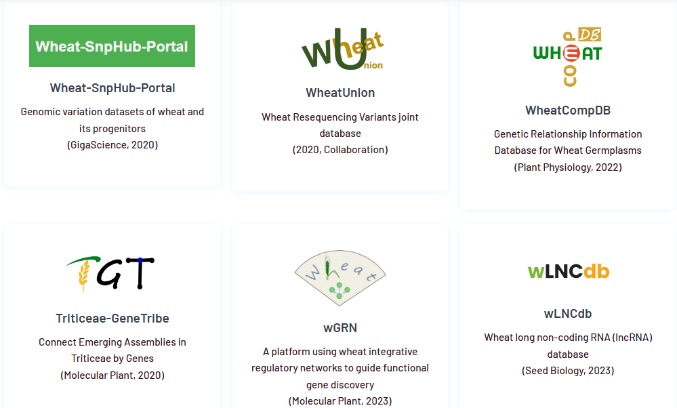


Converting IDs
http://wheat.cau.edu.cn/resources/
Weilong Guo

Slide 33
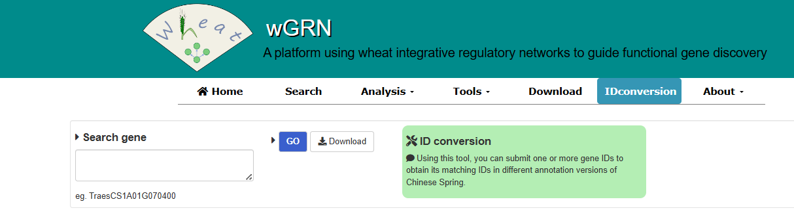
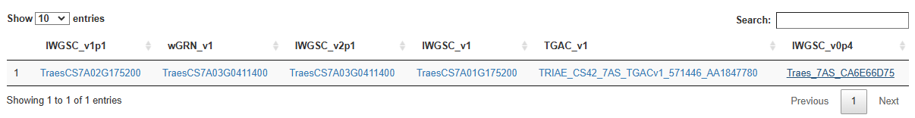
Converting IDs
http://wheat.cau.edu.cn/wGRN/

Slide 34
Tetraploid wheat genome assemblies
 | Svevo (Durum) | Zavitan (Emmer)
Release date | Maccaferri et al., 2019 | Avni et al., 2017
# contigs/ chromosomes | 14 ”chromosomes” + Un | 14 ”chromosomes” + Un
Mean scaffold size | Pseudo chromosomes | Pseudo chromosomes
Assembly Size | 10.45 Gb | 10.1 Gb
Order | “True” physical order | “True” physical order!
Gene names | TRITD3Bv1G000670 TRITD3Bv1G000680 | TRIDC5AG069060 TRIDC5AG069070

Slide 35
Tetraploid wheat genome assemblies
 | Svevo (Durum) | Zavitan (Emmer)
Release date | Maccaferri et al., 2019 | Avni et al., 2017
# contigs/ chromosomes | 14 ”chromosomes” + Un | 14 ”chromosomes” + Un
Mean scaffold size | Pseudo chromosomes | Pseudo chromosomes
Assembly Size | 10.45 Gb | 10.1 Gb
Order | “True” physical order | “True” physical order!
Gene names | TRITD3Bv1G000670 TRITD3Bv1G000680 | TRIDC5AG069060 TRIDC5AG069070
Assembly
version
Species: Triticum turgidum
TRITD3Bv1G000670
Chromosome
Gene number

Slide 36
Tetraploid wheat genome assemblies
 | Svevo (Durum) | Zavitan (Emmer)
Release date | Maccaferri et al., 2019 | Avni et al., 2017
# contigs/ chromosomes | 14 ”chromosomes” + Un | 14 ”chromosomes” + Un
Mean scaffold size | Pseudo chromosomes | Pseudo chromosomes
Assembly Size | 10.45 Gb | 10.1 Gb
Order | “True” physical order | “True” physical order!
Gene names | TRITD3Bv1G000670 TRITD3Bv1G000680 | TRIDC5AG069060 TRIDC5AG069070
High Confidence
Low Confidence
TRITD3Bv1G000670
TRITD3Bv1G000680
LC integrated and lacking distinction

Slide 37
Tetraploid wheat genome assemblies
 | Svevo (Durum) | Zavitan (Emmer)
Release date | Maccaferri et al., 2019 | Avni et al., 2017
# contigs/ chromosomes | 14 ”chromosomes” + Un | 14 ”chromosomes” + Un
Mean scaffold size | Pseudo chromosomes | Pseudo chromosomes
Assembly Size | 10.45 Gb | 10.1 Gb
Order | “True” physical order | “True” physical order!
Gene names | TRITD3Bv1G000670 TRITD3Bv1G000680 | TRIDC5AG069060 TRIDC5AG069070
Species: Triticum dicoccoides
TRIDC5AG069060
Chromosome
Gene number

Slide 38
Tetraploid wheat genome assemblies
 | Svevo (Durum) | Zavitan (Emmer)
Release date | Maccaferri et al., 2019 | Avni et al., 2017
# contigs/ chromosomes | 14 ”chromosomes” + Un | 14 ”chromosomes” + Un
Mean scaffold size | Pseudo chromosomes | Pseudo chromosomes
Assembly Size | 10.45 Gb | 10.1 Gb
Order | “True” physical order | “True” physical order!
Gene names | TRITD3Bv1G000670 TRITD3Bv1G000680 | TRIDC5AG069060 TRIDC5AG069070
High Confidence
Low Confidence
TRIDC5AG069060
TRIDC5AG069070
LC integrated and lacking distinction

Slide 39



Slide 40
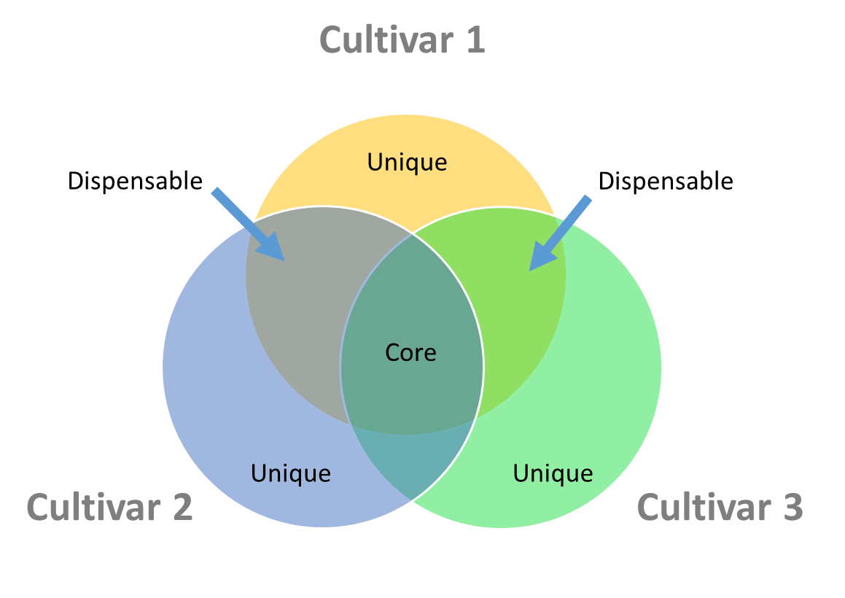
Need for pan-genome
Single reference is not fully representative
Importance of CNV (copy number variation) and PAV (presence absence variation) in phenotype
Complete atlas of the gene content

Slide 41
Variety | Habit | Origin
Lancer | spring | Australia
Mace | spring | Australia
CDC Landmark | spring | Canada
CDC Stanley | spring | Canada
Paragon | spring | UK
Cadenza | spring | UK
Weebil | spring | CIMMYT
Robigus | winter | UK
Claire | winter | UK
Arina | winter | Switzerland
Julius | winter | Germany
Norin-61 | winter | Japan
Jagger | winter | US
SY Mattis | winter | Syngenta
PI 190962 | spring | Italy
Kronos | spring | US
Svevo | spring | Italy
Zavitan | - | Israel
Abbreviation
LAC
MAC
LDM
STA
PAR
CAD
WEE
ROB
CLE
ARI
JUL
NOR
JAG
SYM
TSP
-
TRITD
TRIDC
Bread wheat (6x)
Spelt (6x)
Durum wheat (4x)
Wild emmer (4x)

Slide 42

Variety | Habit | Origin
Lancer | spring | Australia
Mace | spring | Australia
CDC Landmark | spring | Canada
CDC Stanley | spring | Canada
Paragon | spring | UK
Cadenza | spring | UK
Weebil | spring | CIMMYT
Robigus | winter | UK
Claire | winter | UK
Arina | winter | Switzerland
Julius | winter | Germany
Norin-61 | winter | Japan
Jagger | winter | US
SY Mattis | winter | Syngenta
PI 190962 | spring | Italy
Kronos | spring | US
Svevo | spring | Italy
Zavitan | - | Israel
Abbreviation
LAC
MAC
LDM
STA
PAR
CAD
WEE
ROB
CLE
ARI
JUL
NOR
JAG
SYM
TSP
-
TRITD
TRIDC

Slide 43
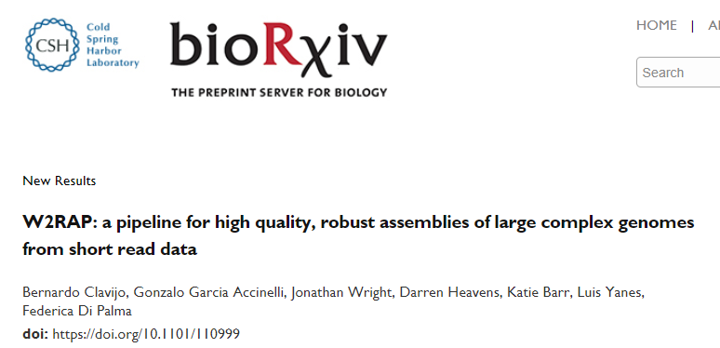
Variety | Habit | Origin
Lancer | spring | Australia
Mace | spring | Australia
CDC Landmark | spring | Canada
CDC Stanley | spring | Canada
Paragon | spring | UK
Cadenza | spring | UK
Weebil | spring | CIMMYT
Robigus | winter | UK
Claire | winter | UK
Arina | winter | Switzerland
Julius | winter | Germany
Norin-61 | winter | Japan
Jagger | winter | US
SY Mattis | winter | Syngenta
PI 190962 | spring | Italy
Kronos | spring | US
Svevo | spring | Italy
Zavitan | - | Israel
Abbreviation
LAC
MAC
LDM
STA
PAR
CAD
WEE
ROB
CLE
ARI
JUL
NOR
JAG
SYM
TSP
-
TRITD
TRIDC

Slide 44
Pangenome gene models
(Up to) 2 sets of gene models
Genes projected from CS RefSeq
TraesLAC3A01G200500
de novo gene models (PGSB or TGAC/EI)
TraesLAC3A03G01319900 (PGSB)
TraesCAD_scaffold_000001_01G000200 (TGAC/EI)

Slide 45
Pangenome gene model nomenclature
TraesLAC3A01G200500
equivalent
TraesLAC3A03G01319900
TraesCS 3A02G178400
TraesLAC3A03G01319900
TraesARI3A03G01396120
TraesJAG3A03G01385130
TraesMAC3A03G01374260
equivalent

Slide 46














Multi-national partnership
Curtis Pozniak

Slide 47
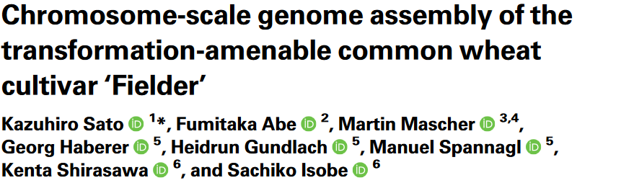
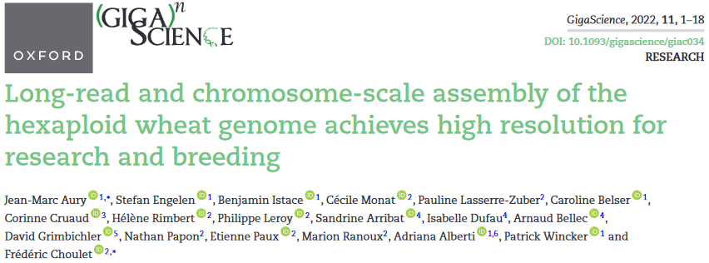
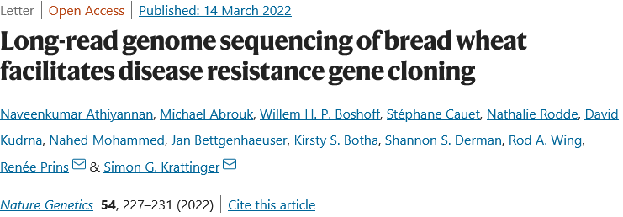
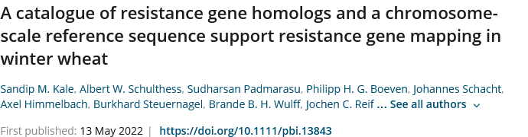
An avalanche of assemblies

Slide 48


Accessing data
Ensembl Plants
http://plants.ensembl.org/index.html
GrainGenes
https://wheat.pw.usda.gov/blast/

Slide 49
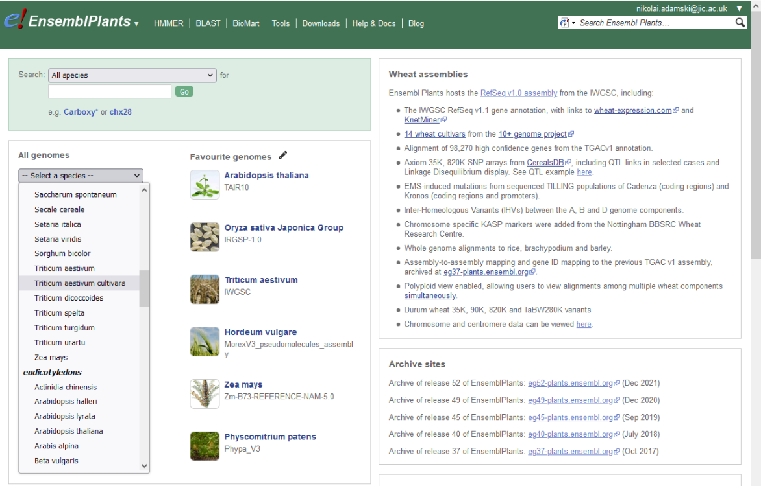
Accessing data via Ensembl Plants
http://plants.ensembl.org/index.html

Slide 50
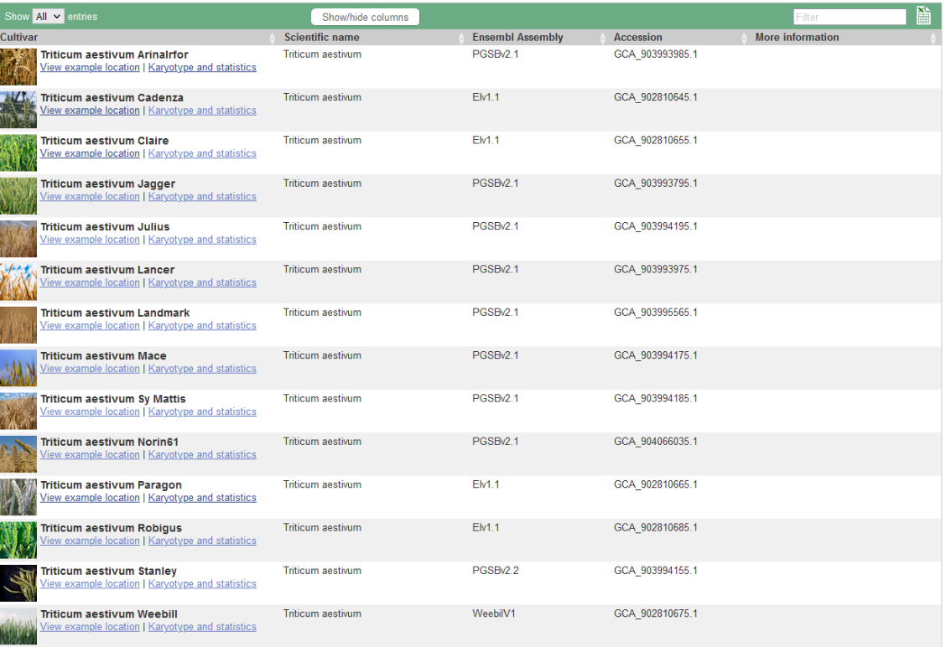
Accessing pangenome cultivars

Slide 51
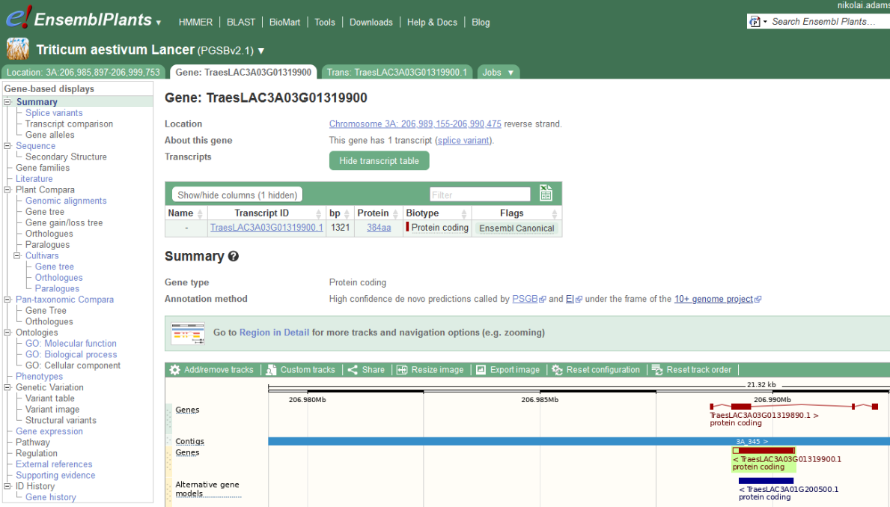
Accessing pangenome cultivars
Get homologs and orthologs from other species / wheat accessions (1-by-1)

Slide 52
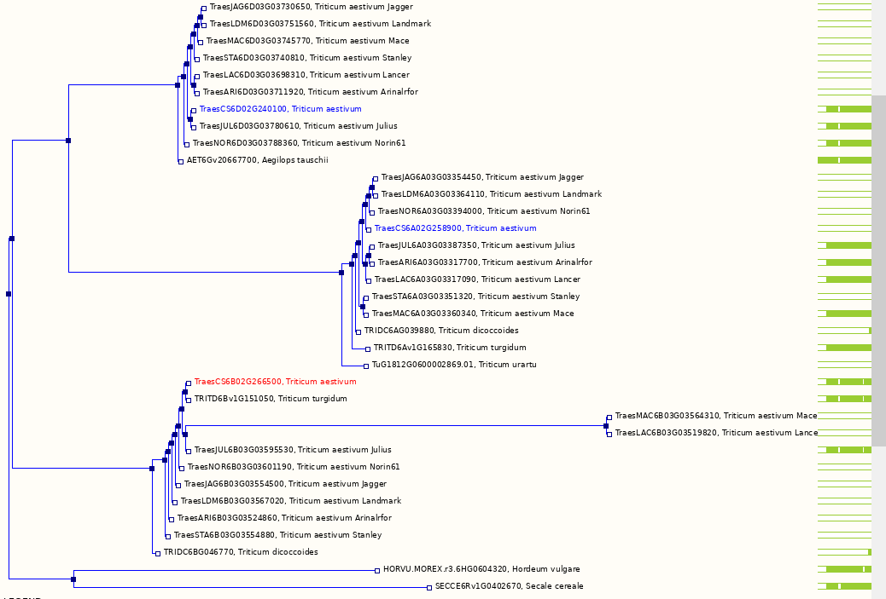
Accessing pangenome cultivars

Slide 53
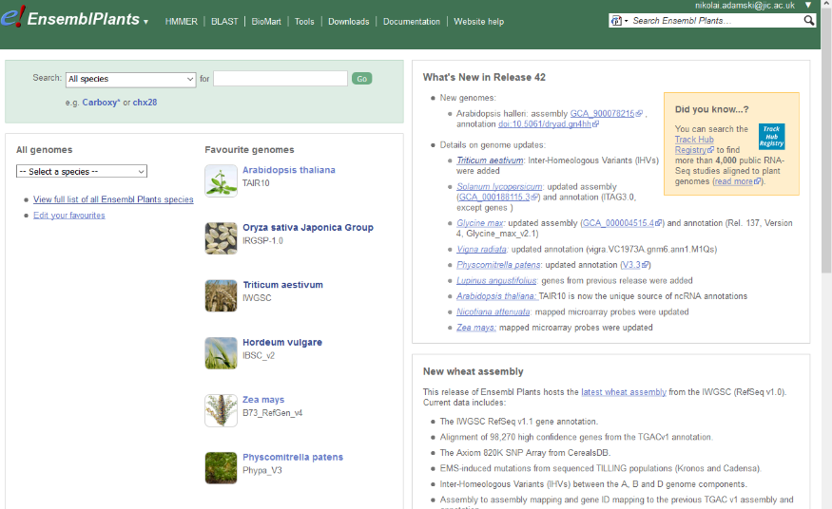
BioMart - get ALL the data

Slide 54
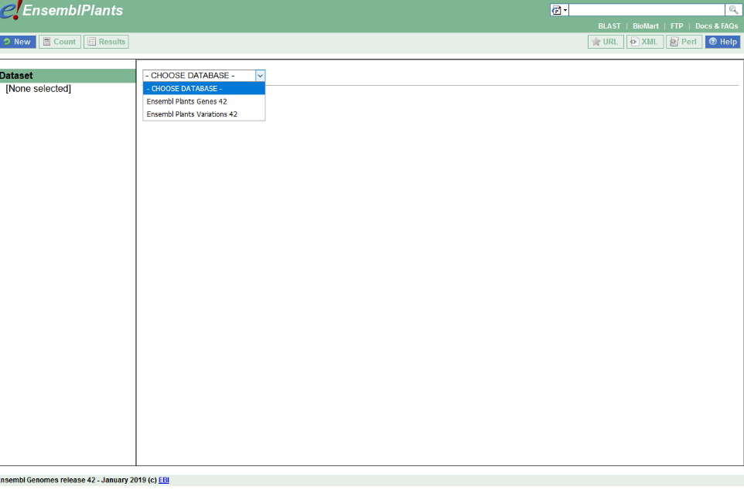
BioMart

Slide 55
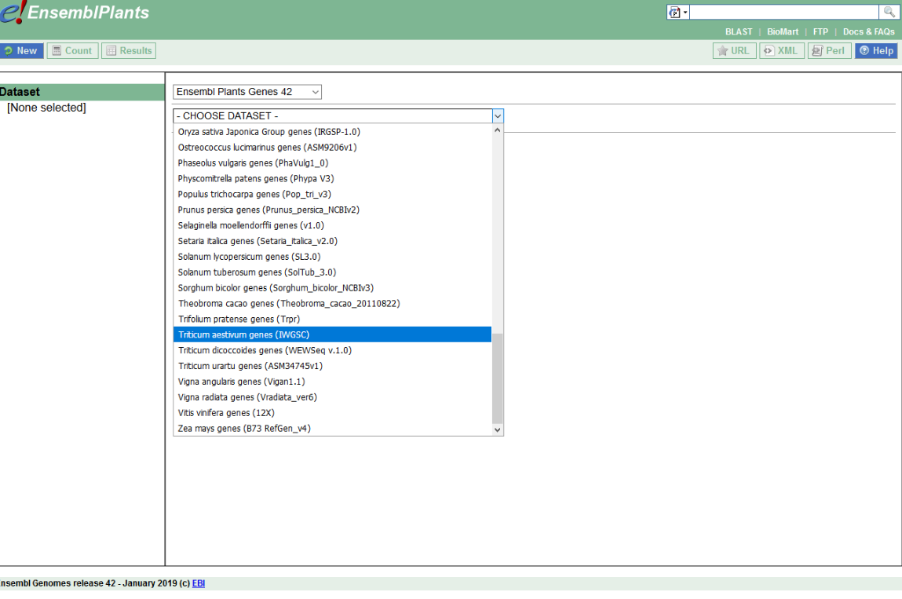
BioMart

Slide 56
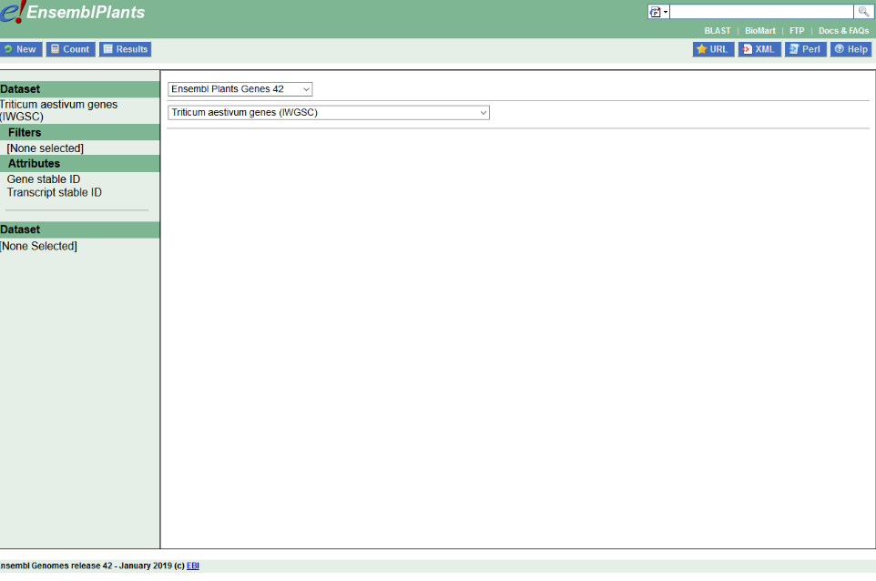
BioMart
Filters, e.g.
chromosome
Position
SNP-type
Attributes, e.g.
Genes in interval
Gene sequences (genomic, CDS, cDNA, etc)
Gene orthologs

Slide 57
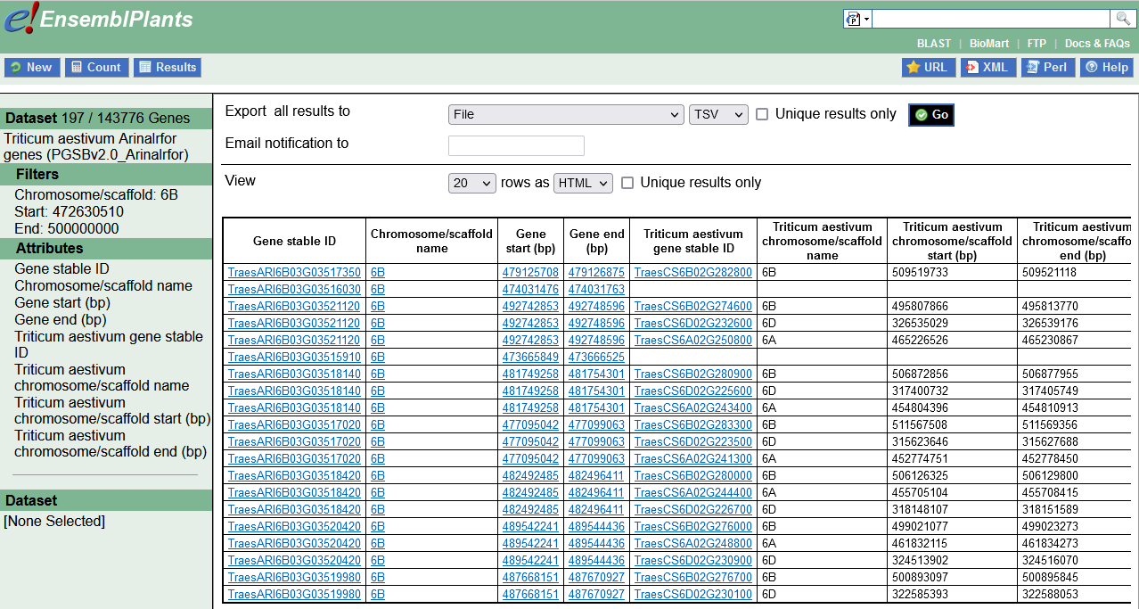
BioMart

Slide 58
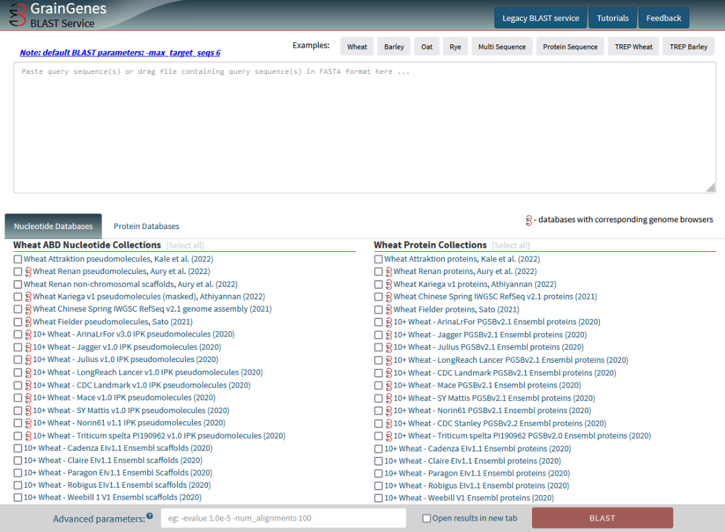
GrainGenes BLAST portal

